Slide 1
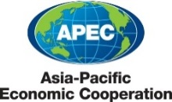
APEC WRF Survey on Laboratory Capacity Building: Recommendations from the survey. Session 6: Enhanced Risk Controls Beijing International Convention Center September 12, 2014

Slide 2
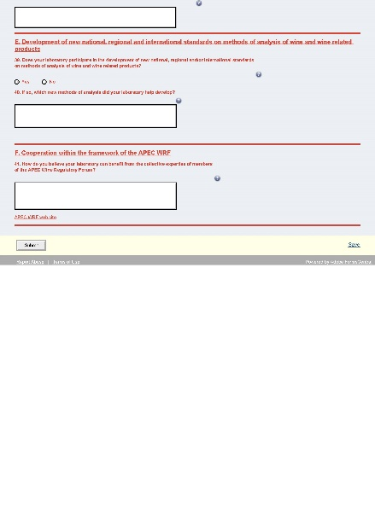
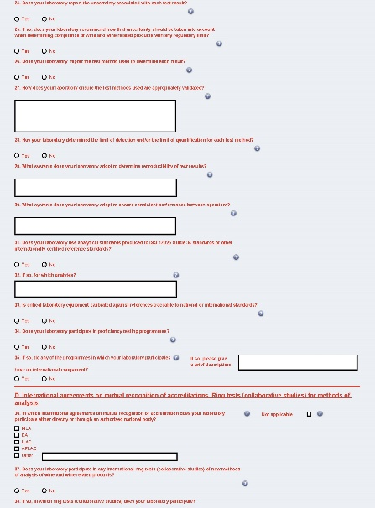
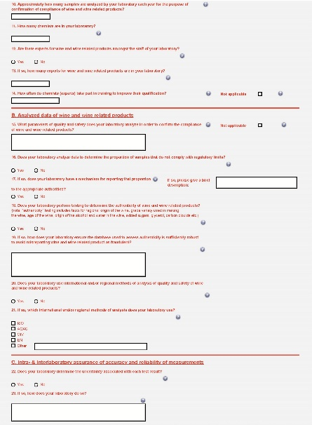
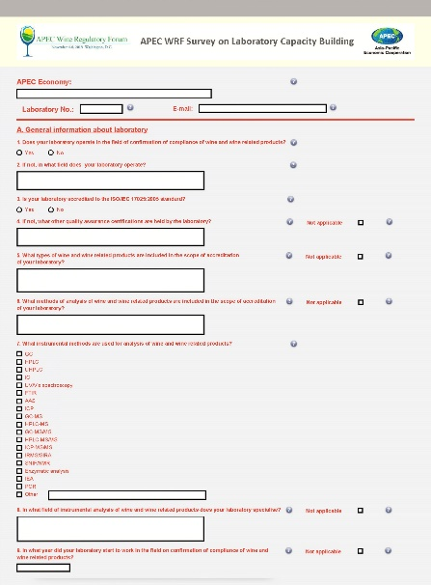
APEC WRF Survey on Laboratory Capacity Building:
Application on-line form
https://adobeformscentral.com/?f=gTWcrKY5Y7FZV4yvpro9bA#

Slide 3
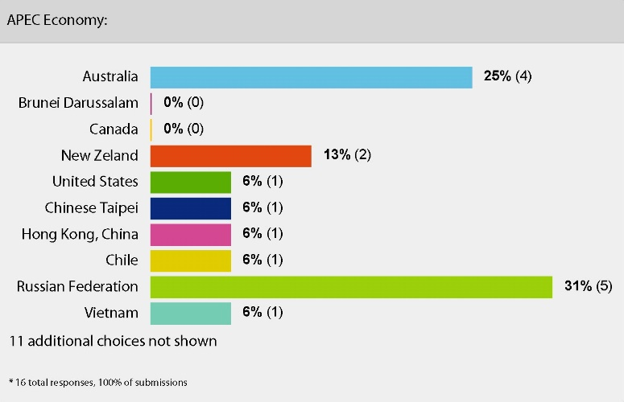
APEC WRF Survey on Laboratory Capacity Building:
Responding laboratories
16 laboratories from 8 economies (July 30, 2014):
Australia
Chile
Chinese Taipei
Hong Kong, China
New Zealand
Russian Federation
United States
Viet Nam

Slide 4
APEC WRF Survey on Laboratory Capacity Building:
Recommendations – ring tests (proficiency testing)
Establishment of a programme of ring tests
Analytes proposed for ring tests (e.g. alcohol, methanol, sulphites)
Testing of metals (exceeding of limits & risk assessment for the establishment of limits)
Platform for ring tests (The Asia-Pacific Laboratory Accreditation Cooperation – APLAC)

Slide 5
APEC WRF Survey on Laboratory Capacity Building:
Recommendations – accuracy & reliability of analytical results
Determination of the uncertainty (LOD/LOQ) associated with test results
Knowledge sharing (volunteer labs and/or experts; guideline for determination of uncertainty)

Slide 6
APEC WRF Survey on Laboratory Capacity Building:
Recommendations – mutual recognition of testing reports
APEC objective for trade facilitation & ISO 17025 accreditation
Exploration of means for acceptance of testing reports

Slide 7
APEC WRF Survey on Laboratory Capacity Building:
Recommendations – experience & knowledge of chemists (experts)
Sharing test methods, ideas, findings & initiatives
Hosting laboratories for experience & knowledge sharing

Slide 8
APEC WRF Survey on Laboratory Capacity Building:
Recommendations – methods of analysis (analytes)
Establishment of a compendium of methods of analysis (in cooperation with the Working Group on Compendia)
Evaluation of method’s performance
Priority test methods (parameters important for human health & safety)

Slide 9
APEC WRF Survey on Laboratory Capacity Building:
Recommendations – basic issues resulting from the survey
Ring test (proficiency testing)
Accuracy & reliability of analytical results
Mutual recognition of testing reports
Experience & knowledge of chemists (experts)
Methods of analysis (analytes)

Slide 10
APEC WRF Working Group on Enhanced Risk Controls:
Steve Guy, Australia (chair) – steve.guy@awbc.com.au
Tony Battaglene, Australia – tony@wfa.org.au
Tian Ling, China – tianling2008@yahoo.com
Wang Cheng, China – Wangc@shciq.gov.cn
Shi Yiyin, China – shiyy@shciq.gov.cn
Ni Xinlu, China – nixl@shciq.gov.cn
Alexander Kolesnov, Russian Federation – sekretariat@biolab.ru
Stefan Lin, Chinese Taipei – cwlin@mail.nta.gow.tw
Patricia Nedialkova, United States – Patricia.Nedialkova@ttb.gov
Vien Chinh, Viet Nam – chienvc66@yahoo.com

Slide 11
THANK YOU FOR ATTENTION

