Slide 1
Establishment of a compendium of methods of analysis & New test methods development Session 6: Enhanced Risk Controls Beijing International Convention Center September 12, 2014

Slide 2
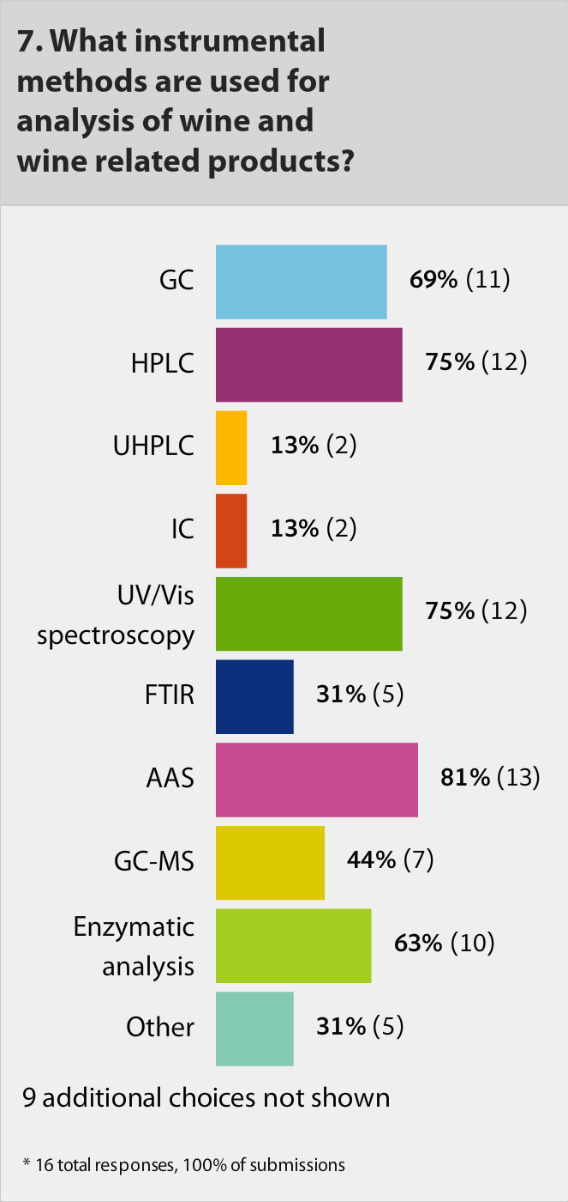
APEC WRF Survey on Laboratory Capacity Building:
Responding laboratories - Top 10 instrumental methods
AAS
HPLC
UV/VIS spectroscopy
GC
Enzymatic analysis
GS-MS
FTIR
Other (e.g. capillary electrophoresis)
UHPLC
IC
APEC WRF survey results (2014)

Slide 3
APEC WRF Survey on Laboratory Capacity Building:
Responding laboratories – instrumental specialization
The most common instrumental methods:
GC
UV/VIS spectroscopy
AAS
Enzymatic analysis (manual or automated)
HPLC
Methods with high methodological and instrumental component:
UHPLC
GC-MS/GC-MS/MS
HPLC-MS, HPLC-MS/MS
ICP-MS, ICP-MS/MS
IRMS/SIRA

Slide 4
Establishment of a compendium of methods of analysis:
Basic meaning of the proposal - application of fit for purpose methods and not using the same method for each analyte
Establishment of a non-binding reference guideline for providing the selection of proper and fit for purpose methods of analysis for their application in confirmation of compliance and authentication as well as for risk controls in production and trade of wine and wine products in the APEC economies

Slide 5
Establishment of a compendium of methods of analysis:
Possible concepts for development of the compendium – based on existing fit for purpose international methods of analysis
List of methods of analysis (simplified concept)
List of methods of analysis focused on product’s parameters (e.g. existing documents - compendium of OIV methods; international standards of the Codex Alimentarius Commission for product commodities)
List of methods of analysis focused on scopes of application (e.g. existing documents - codes of practices of international NGOs)

Slide 6
Establishment of a compendium of methods of analysis:
Form factor of the compendium
Electronic format for direct access via network
Network hosting of the compendium based on the experience and proposals of the Working Group on Compendia of the APEC WRF Multi-Year Project (e.g. Compendium on Labelling, Safety, Pesticide MRLs)

Slide 7
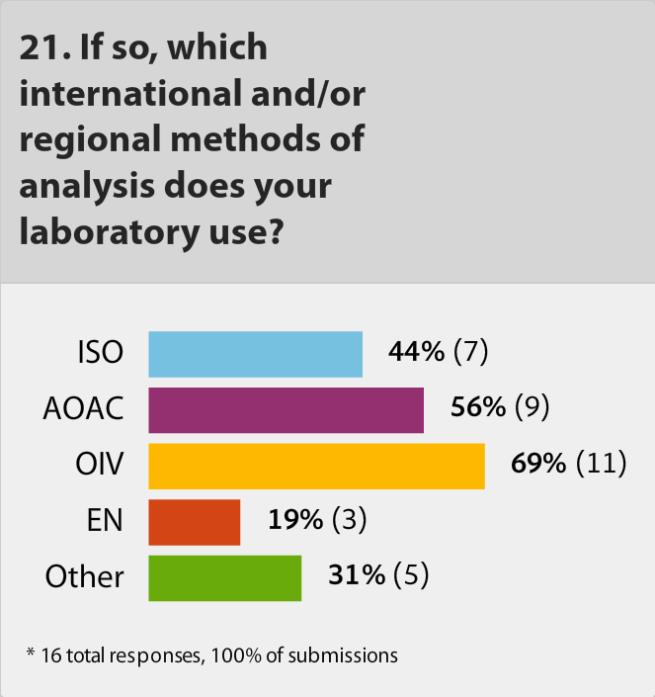
Establishment of a compendium of methods of analysis:
Content
Priority on existing international methods of analysis of wine & wine products (e.g. OIV, AOAC, ISO methods according to the results from the APEC WRF laboratory survey)
Inclusion of new methods of analysis according to proposals from APEC WRF economies
Inclusion of guidelines for laboratory quality assurance practice (e.g. determination of LOD/LOQ, measurement uncertainty etc.)
APEC WRF survey results (2014)

Slide 8
Establishment of a compendium of methods of analysis:
Arising question of using existing international methods
Publication of existing international methods?
- in full text
or
- as links to sources with the published methods

Slide 9
New test methods development:
Basic meaning
Implementation of fit for purpose methods
Enhancement of methodological and instrumental capabilities
Extension of list of measured parameters (analytes)
Ensuring compliance of methodological and instrumental laboratory resources to new risks and threats to safety and authenticity of wine and wine products
Ensuring compatibility of measurement results between different methods

Slide 10
New test methods development:
Possible priority task - enhancement (extension) of methodological and instrumental capabilities
Through existing fit for purpose methods (e.g. ascorbic acid – enzymatic analysis/HPLC; sorbitol – enzymatic analysis/HPLC; sulphur dioxide – enzymatic analysis/titrimetry; metals – AAS/ICP etc.)
Through new methods (e.g. pesticides – GC-MS, HPLC-MS/MS; mycotoxins – HPLC-MS/MS; oenocyanines “color extracts from grapes” – HPLC; sugar ingredients “invert sugar, HFS from starch” – capillary GC; chaptalization – 2-hydroacetylfuran as indicator for invert sugar by the GC-MS method; wine water – isotopic equilibration by ¹⁸O/ ¹⁶O isotopes method; synthetic ethanol – ¹⁴C-isotope method etc.)

Slide 11
New test methods development:
Proposed procedural steps
Generating of initiative proposal(s) for new method
Submission of the proposal to the Working Group
Checking prospects for application of the proposed method
If approved: 1 - development of the draft method by initiator of proposal(s) or 2 – description of existing method recommended for inclusion in the compendium
Preparation and conducting of collaborative study for proposed method validation (if necessary) (e.g. collaborative study based on the APEC WRF platform for ring tests)
Endorsement of the new method by the APEC WRF economies
Inclusion (publication) of the endorsed method in the APEC WRF compendium on methods of analysis

Slide 12
New test methods development:
Examples of new methods - isotopic techniques for wine authentication
Wine water – ¹⁸O/ ¹⁶O isotopes ratio by the IRMS/SIRA isotopic equilibration method
Wine ethanol & glycerol – ¹³C/ ¹²C, ¹⁸O/ ¹⁶O & ²H/ ¹H isotopes ratio by the IRMS/SIRA-GC method
Wine sugars - ¹³C/ ¹²C, ¹⁸O/ ¹⁶O & ²H/ ¹H isotopes ratio by the IRMS/SIRA-FC/HTP method

Slide 13
Extra issues of increasing interest:
Development of protocols focused on applied tasks
Basic meaning: establishment of non-binding guidelines (protocols) which are comprehensive and sufficient for preparation and carrying out the analytical and expert procedures focused on solving of specific problem(s) in connection with the confirmation of compliance, risk controls and/or authentication of wine and wine products in the APEC economies

Slide 14
Extra issues of increasing interest:
Development of protocols focused on applied tasks – model structure of the document
Purpose and scope of the application of the protocol (description of the applied problem to be solved)
Analytical steps (lists of target parameters/analytes & applied methods)
Calculation of results (metrological issues)
Criteria used for the interpretation of results (e.g. qualitative evaluation or quantitative ranges; data charts; factors to be taken into account when interpreting the results etc.)
Reference publications (e.g. compendia, code of practices, standards, official methods etc.)
Conclusion (report )

Slide 15
Extra issues of increasing interest:
Development of protocols focused on applied tasks – example 1
Model analytical steps of the Protocol for detection of sugar addition
after vinification
(conventional approach)
Step # | Attribute (parameter matrix) | Method | Quantitative or qualitative criteria
1 | Carbohydrates: 1.1 D-glucose 1.2 D-fructose 1.3 D-glucose/D-fructose 1.4 Ttotal sugar 1.5 Proportion of D-glucose | EA/HPLC EA/HPLC Calculation Calculation Calculation | Published & confirmed ranges of values
2 | Alcohols: 2.1 Ethanol 2.2 Total ethanol | EA/GC Calculation
3 | 3.1 Degree of fermentation | Calculation
4 | 4.1 Correlation between proportion of D-glucose and degree of fermentation | Correlation chart | Correlations must be within the established area

Slide 16
Extra issues of increasing interest:
Development of protocols focused on applied tasks – example 2
Model analytical steps of the Protocol for detection of additions
of ethanol or glycerol in wine
(conventional approach)
Step # | Attribute (parameter matrix) | Method | Quantitative or qualitative criteria
1 | Ethanol | EA/GC | Published & confirmed ranges of values
2 | Glycerol | EA/GC/HPLC/Colorimetry
3 | 2.3-Butanediol | Colorimetry
4 | Glycerol factor | Calculation
5 | 2.3-Butanediol factor

Slide 17
Extra issue of increasing interest:
Development of protocols focused on applied tasks – example 3
Model analytical steps of the Protocol for detection of additions of non-grape alcohol (sugar) from C4 plants in wine & wine products
(Isotopic Single Element Approach – ISEA)
Step # | Attribute (parameter matrix) | Method | Quantitative or qualitative criteria
1 | ¹³C/¹²C isotopes in carbohydrates (D-glucose, D-fructose) | IRMS/SIRA | Published & confirmed ranges of values
2 | ¹³C/¹²C isotopes in alcohols (ethanol)

Slide 18
Extra issues of increasing interest:
Development of protocols focused on applied tasks – example 4
Model analytical steps for the Protocol for detection of additions of non-grape alcohol (sugar)
from C3 & C4 plants in wine & wine products
(Isotopic Multi Elements Approach – IMEA)
Step # | Attribute (parameter matrix) | Method | Quantitative or qualitative criteria
1 | Main part: 1.1 ¹³C/¹²C isotopes in ethanol 1.2 (D/H)₁ isotopes in ethanol 1.3 ¹⁸О/¹⁶O isotopes in water | IRMS/SIRA SNIF/NMR IRMS/SIRA | Published & confirmed ranges of values
2 | Additional part: 2.1 D/H isotopes in ethanol 2.2 D/H isotopes in sugars 2.3 ¹³C/¹²C isotopes in sugars 2.4 ¹⁸О/¹⁶O isotopes in sugars | IRMS/SIRA

Slide 19
THANK YOU FOR ATTENTION

