Slide 1

Laboratory Methods Workshop
Alcohol
Dr Eric Wilkes
The Australian Wine Research Institute

Slide 2
1. Chemical entity
Wine is the product of the fermentation of the grape sugars glucose and fructose through to ethanol.
Ethanol in wine is usually present at levels in excess of 7% volume by volume (more than 70g/L).
In wine when we refer to alcohol we are referring to its ethanol content, which is by far the most significant alcohol present in wine.
There are a number of other alcohols in wine but they are present at such small levels that they have no significant impact on the measurement of ethanol by typical methods.
Ethanol content in beverages is strictly regulated and as such there are legal requirements for accuracy of labelling. As such the accurate measurement of alcohol is very important.

Slide 3
2. Units of measurement
Typically alcohol is expressed in terms of % content volume / volume.
This is based on the historical measurement of alcohol, usually by hydrometry, where the most practical way to make standards was on a volume by volume basis.
It should be remembered that because of the nature of partial molar volumes it is not sim or practical to convert alcohol v/v to other concentration units such as g/L.

Slide 4
3. Limits of Measurement
APEC 2015 Ring Test Results (%v/v)
White
Red
Importantly, standard deviations of 0.19 and 0.25 for whites and red respectively

Slide 5
3. Limits of measurement
2015 Interwinery Results (%v/v)
Round 1 |  |  | Round 2 |  |  | Round 3
n | Ave | SD | n | Ave | SD | n | Ave | SD
NIR
93 | 14.22 | 0.08 | 93 | 14.22 | 0.08 | 100 | 14.23 | 0.08
94 | 13.99 | 0.08 | 95 | 14.00 | 0.09 | 98 | 13.98 | 0.07
Distillation/ hydrometer
15 | 14.00 | 0.19 | 17 | 13.95 | 0.19 | 15 | 13.91 | 0.41
11 | 13.95 | 0.18 | 13 | 13.83 | 0.24 | 11 | 13.96 | 0.24

Slide 6
4. Methodologies
There are currently 3 common methods for measuring the alcohol content of wine;
Ebulliometry, which relies on measuring the depression in boiling point of wine compared to water. While highly accurate it requires skilled technicians and careful preparation.
Distillation followed by hydrometry, which involves the separation of the alcohol content from the wine matrix, making it back to a constant volume with water and then determination of ethanol content by densitometry.
Near Infrared (NIR) analysis, which is an automated method which relies on using a spectrometer to measure certain peaks in the near infrared spectra of wine. This technique is very simple to use and is very reliable, however involves relatively expensive dedicated equipment.
A number of mid infrared fourier transform (FTIR) instruments are also now available which offer alcohol analysis simultaneously with a number of other analytes, however these still tend to be quite expensive and require careful calibration.
Gas chromatography is also an accepted method for the determination of ethanol in wine, however the relatively high levels of ethanol found in wine require significant dilution for this technique reducing any relative gains in accuracy.

Slide 7
Practical application
Distillation / Hydrometry
The technique works removing and collecting the alcohol component of a known volume of wine by distillation.
The collected alcohol is then made up to the same volume as the original wine sample.
The density of this solution is related to the alcohol content which is determined by a hydrometer which is calibrated in % alcohol units.
Temperature of the distillate is measured to allow the hydrometer reading to be corrected to it’s calibrated value.
The density can also be determined using a density meter and using appropriate alcohol density tables.

Slide 8
Practical application
Distillation
Using a volumetric flask and water bath accurately measure a 250 mL sample of the wine.
Pour the contents into the distillation flask followed by two 100 mL rinses with lab grade water.
Neutralise the solution to ~8.2 with with 2M Ca(OH)₂ and add two boiling chips.
Connect the distillation flask to the condenser and place the original 250 mL volumetric flask under the receiving tube in an ice bath (the tube should go to within a cm of the flask bottom).
Apply heat to the distillation vessel to get a slow boil and distill across approximately 220 mL of solution.
Remove the heat and then rinse any residue in the receiving tube into the flask using 10 mL of water.
Place flask into a 20°C water bath and allow to come to temperature.
Make up to volume with lab grade water.

Slide 9
Practical application
Hydrometry
Rinse the hydrometer cylinder with a small amount of the distillate.
Transfer the distillate to the cylinder ensuring that there is sufficient space to add the hydrometer without it overflowing.
Rinse the hydrometer with a small amount distillate.
Carefully lower the hydrometer into the distillate, it should float without touching the bottom or walls of the cylinder.
Gently spin the hydrometer to remove bubbles.
Once it has settled read the hydrometer at a point just below the meniscus.
With the hydrometer still in solution measure the distillate temperature.
Correct the hydrometer reading for the distillate temperature using the reference tables.
Rinse the hydrometer with ethanol and dry carefully with tissue.

Slide 10
Precautions
It is not possible to use a hydrometer (or density meter) directly on the wine sample as the other wine components such as acids and sugars contribute to the overall density and interfere with the measurement.
  These components are not transferred by the distillation process and hence don’t impact the density of the distillate.
Other wine volatile components such as acetic acid and SO₂ can also be distilled across and can interfere if they are there in sufficient quantities.
  This is overcome by neutralising the wine with Ca(OH)₂. which reduces their volatility to the point where they no longer are transferred.
Ethanol density and volume change with temperature so it is very important to correct readings for difference in measurement temperature from 20∘C.

Slide 11
Common issues/interferents
High volatile acidity or SO₂ can interfere with accurate analysis. These are usually overcome by the addition of Ca(OH)₂ to reduce the volatility of these components.
Low water quality can lead to transfer of interferents to the distillate and degrading accuracy.
The majority of issues tend to be technique based (refer to trouble shooting guide at the end of this section).

Slide 12
Practical application
NIR Methods
Modern NIR instrumentation generally require little intervention from the analyst.
Samples are usually injected directly into the instrument with a direct readout of concentration.
Turbid samples are usually at least centrifuged before analysis to ensure that there are no particulate interferences with the absorbance.

Slide 13
Common issues/interferents
NIR measurements are very sensitive to temperature. While the majority of modern instruments have a degree of inbuilt temperature correction it is important to only present samples at approximately 20 C +/- 2 C.
Most modern NIR instrumentation has a concealed cell. It is important that a rigorous cleaning regime is applied as cell fowling can lead to significant drift and random errors.
Micro-particulate, particularly tartrates, can some times interfere with NIR absorbance. It is important to ensure that the sample is free of any significant turbidity.

Slide 14
Quality control
Distillation
Every 10 sample should be done in duplicate.
Once a month prepare 12.0% v/v ethanol soln, and then distil the sample as per the standard alcohol procedure. The distilled sample should not vary by more than 0.1% from the original.
The hydrometer should be checked regularly against a certified alcohol sample.
At least yearly the hydrometer should be checked for accuracy by a certified testing laboratory.
NIR methods
Every 10th sample should be a known wine.
At the start and end of each day a water blank should be run with the result not varying by more than 0.1% from 0.
On a monthly basis a 12% v/v ethanol standard should be prepared and analysed, with the results not varying by more than 0.1%.
A certified alcohol reference standard should be analysed on a yearly basis.

Slide 15
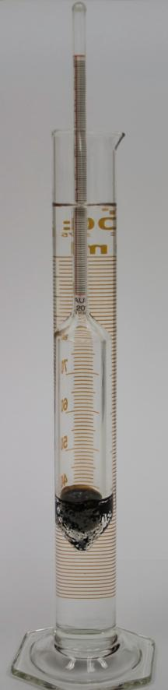
Troubleshooting (hydrometry)
Low quality water can impact alcohols by distillation.
Water temperature in the condenser can make a big difference, either chill or have a decent flow rate for tap water.
Use a slow boil no matter how much of a hurry you are in.
Hydrometers are fragile and don’t bounce. Dropped hydrometers should be disposed of as cracks can be difficult to find.
Badly scratched or small cracks can make a hydrometer inaccurate.
Clean hydrometers with methanol and than distilled water after each use.
Adjust high VA or SO₂ wines to pH 8 with Ca(OH).
Chill the receiving flask to ensure that no distillate escapes.
Make sure the receiving flask is away from direct sunlight or heat.

Slide 16
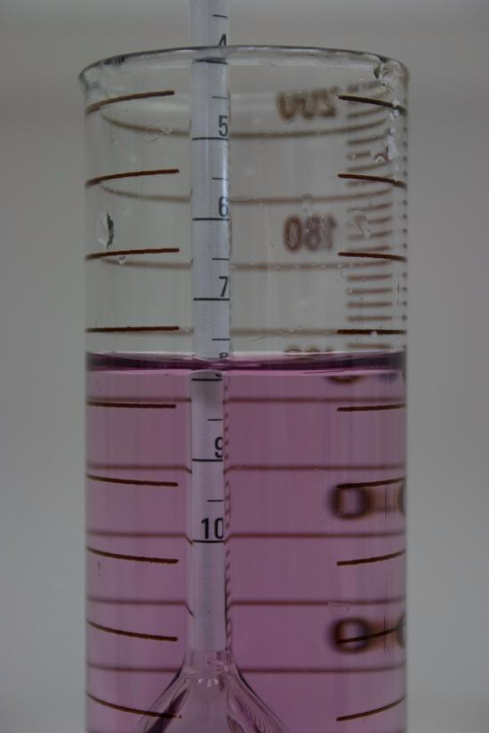
Troubleshooting (hydrometry)
Bring the receiving flask to 20C before making up to volume.
Make sure the hydrometer vessel is not too tight or too loose.
Use anti bumping granules to prevent bumping.
Some high sugar wines will need the use of antifoam.
Use smaller volumes to distill samples with high alcoholic strengths (> 30% v/v)
Calibrate hydrometers regularly

Slide 17
Troubleshooting (NIR)
Never leave wine in the cell, even for a little while.
Always rinse with water after each set of readings.
Be careful with strong detergents, they can damage the cell.
If doing lots of high protein wines you can get a build up, clean occasionally with pectolytic enzyme.
Despite manufacturers assurances, turbid samples can give anomalous results (and block the cell).
Micro-tartrate crystals (off cold stab) can give high results.

Slide 18
Troubleshooting (NIR)
If lots of dirty wine has been put through the cell can be partially blocked leaving dead spots and sample carryover.
Measure close to 20C, the cell heating/cooling can only do so much.
Run regular zero and standards (graph results).
Constantly correcting the zero means there is a problem.
Hand degas sparkling samples (effects of air bubbles on stable readings)
Use syringes without rubber end on plunger (can draw forwards bringing air into system)

Slide 19
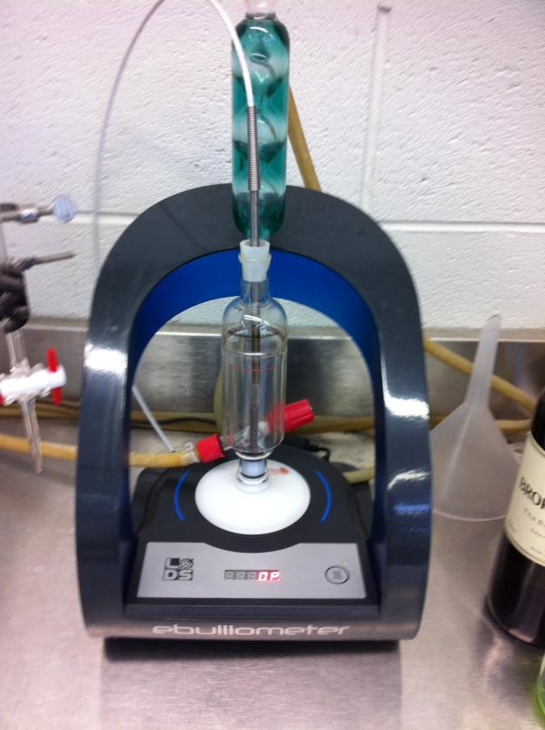
Troubleshooting (ebulliometer)
Keep it spotless.
Changes in atmospheric pressure will impact the results. Do standards and results together.
Make sure standards are within 1% of the measured wine.
Replace the condenser water for each test.
Make sure you take the reading at the first stable point.
High sugar samples need corrections.

