Slide 1

Laboratory Methods Workshop
Sugar
Dr Eric Wilkes
The Australian Wine Research Institute

Slide 2
1. Chemical entity
The most significant naturally occurring sugars in grapes are the hexoses glucose and fructose (G&F).
These are also the most important from a production and sensory point of view.
The small amount of sucrose present in grapes is mostly enzymatically converted to G&F during fermentation, leaving a relatively insignificant quantity in the final wine.
A number of pentoses such as arabinose and rhaminose are present in varying quantities but are not fermentable and do not contribute significantly to sweetness.
Added sucrose (illegal in many economies) is rapidly hydrolysed to G&F in wine conditions and is not usually present in significant quantities, although small amount may remain in some wines.

Slide 3
1. Chemical entity
In most wine producing economies glucose & fructose (G&F) are measured directly as they provide the relevant production, food stability and sensory information.
Older testing methods rely on the capacity of many sugars (but not sucrose) to reduce a cupro-alkaline solution.
These reducing sugar methods measure G&F , but also pentoses and other reducing wine components such as phenolics.

Slide 4
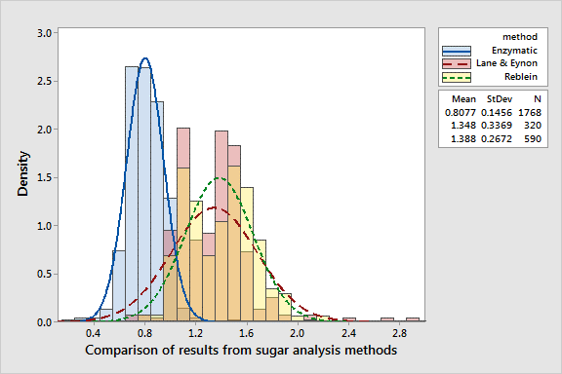
1. Chemical entity

Slide 5
2. Units of measurement
Definitions
Reducing Sugar: - Sugar with an aldehyde or keto- group (for example glucose, fructose and the pentoses, for example arabinose)
-Does not include sucrose
-Should not be confused with reducing substance
Residual Sugar:-All fermentable sugars including sucrose plus pentoses
Reducing Substance: Includes glucose and fructose, plus oligosaccharides, and other reducing matter (such as tannin and Polyphenols)
Non-fermentable Carbohydrates: These include pentoses, polysaccharides, (and pectins, tannins, pigments, all of which may interact with carbohydrates to form complexes).
Note that the first 3 definitions above are all abbreviated ‘RS’ although they represent different meanings. The term residual sugar with reference to wine is understood to mean the sum of glucose, fructose (reducing sugars) and the non-reducing sugar, sucrose.

Slide 6
2. Units of measurement
Glucose and fructose (G&F) measurement is reported in grams per litre (g/L) of sugar present in solution.
Reducing sugar measurements are reported as g/L equivalence to the glucose solution used as a standard during the titration.
The term total sugars refers to the measurement of all sugars present in solution, is reported in g/L, and is often inaccurately considered equivalent to reducing sugars.
The use of the term residual sugar varies around the world and in some economies refers to remaining fermentable sugars (i.e. G&F) and in others total sugars. The definition in the previous slide is considered the most correct.

Slide 7
3. Limits of Measurement
APEC 2015 Ring Test Results
White
Red
Importantly, standard deviations of 0.9 and 1.4 for whites and red respectively

Slide 8
3. Limits of measurement (RS)
2015 Interwinery Results
Round 1 |  |  | Round 2 |  |  | Round 3
n | Ave | SD | n | Ave | SD | n | Ave | SD
50 | 2.18 | 0.50 | 44 | 2.12 | 0.46 | 44 | 2.17 | 0.43
46 | 4.24 | 0.78 | 42 | 4.34 | 0.80 | 42 | 4.51 | 0.56

Slide 9
3. Limits of measurement (GF)
2015 Interwinery Results
Round 1 |  |  | Round 2 |  |  | Round 3
n | Ave | SD | n | Ave | SD | n | Ave | SD
103 | 0.89 | 0.21 | 110 | 0.92 | 0.23 | 111 | 0.92 | 0.23
112 | 2.29 | 0.47 | 110 | 2.30 | 0.41 | 112 | 2.35 | 0.61

Slide 10
4. Methodologies
Glucose and Fructose
Most commonly measured using enzymatic based test kits (which are specific to G&F) and a spectrometer.
Also regularly done using high performance liquid chromatography (HPLC) which is often considered the reference method and can also be used for total sugars.
Reducing sugar methods
There are two common titrimetric methods both relying on the ability of Cu(II) to be reduced by monosaccharides in alkaline conditions.
Commonly referred to as the Rebelein and Lane & Eynon methods.

Slide 11
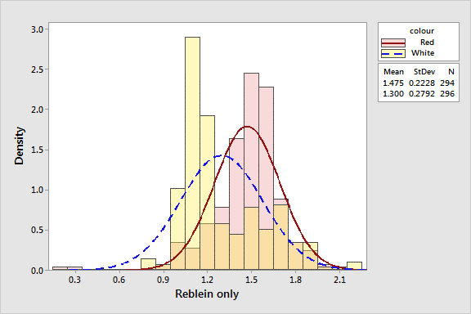
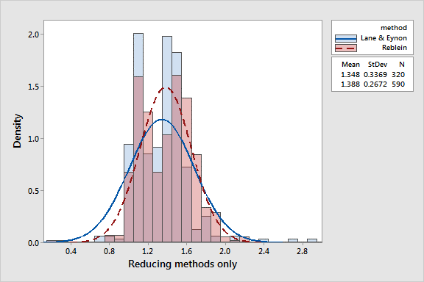
4. Methodologies
GF measures are relatively high throughput and very specific to the analytes in question.
But they do need accurate micropipettes and a spectophotometer or automated analysers.
Reducing methods suffer from significant interferences in the wine matrix including colour (see top graph).
They do however require relatively simple equipment and the two main methods give broadly equivalent results.

Slide 12
Practical application
Glucose & Fructose by enzymatic Kit
Details of the testing steps vary from manufacturer to manufacturer, but the steps are essentially the same.
The sample is filtered to remove particulate and diluted to an appropriate value.
The sample is added to a buffer solution to bring it to the appropriate pH .
The enzymes NADP/ATP are added and after around 3 minutes the absorbance (A1) is measure at 340 nm to give a background level.
A mixture of the enzymes HK/G6P-DH are then added to the solution, mixed and a further incubation in the region of 10 minutes is allowed. ATP in the presence of HK converts the glucose and fructose to their respective phosphates. The glusose-6-phospahte is then converted to the gluconate by NADP in the presence of GSPDH producing stoichiometric amounts of NADPH which produce a peak in the visible spectrum at 340 nm.
The Absorbance is then measured again at 340nm (A2). A1 is then subtracted from A2 and the result is compared to a calibration curve to determine glucose content.
PGI is added to convert the fructose-6-phosphate to the glucose-6-phosphate, which then proceed to react in the same manner as described in step 4.
After 10 minutes absorbance is measured again (A3). A2 is subtracted from A3 and the value is compared to a calibration curve to determine the fructose content.
The two values are then added together to get the glucose + fructose content of the sample in g/L.

Slide 13
Precautions
Glucose & Fructose by enzymatic Kit
In general the concentration of the assay solution must be no greater than 1 g/L glucose and fructose. In practice this means that dry wine styles need to be diluted 1 in 10, and sweeter styles must have higher dilutions.
Blank solutions using water rather than sample are always run in parallel with the the samples and the appropriate blank absorbance is subtracted from each absorbance.
While most reagent kits come with suggested conversion factors to directly convert absorbance to g/L of glucose and fructose, it is recommended that regular calibration curves be done to take into account deterioration of reagents and small differences in instruments.
The commercial kits can be used on a wide range of instrumentation from simple spectrophotometers through to large automated sequential analysers.

Slide 14
Practical application
Reducing Sugar by Rebelein
The wine should be decolourised if necessary.
Into a 125 mL flask pipette 10mL of Z1* and 5mL of Z2.
Pipette 2 mL of purified water into flask and add boiling chips.
Heat flask to boiling for 30 seconds and allow to cool to room temperature.
Add 10 mL of each of Z3, Z4 and Z5 in that order to the flask.
Immediately titrate with Z6 (thiosulfate solution) from a 50 mL burette with mixing until solution is a cream colour.
Repeat the entire procedure substituting the 2 mL of water for 2 mL of sample.
Sugar is given in g/L by, dilution factor x (titre 1 – titre 2)
*For information on solutions Z1-Z6 p71 of Illand et al, “Chemical analysis of grapes and wine: techniques and concepts”.

Slide 15
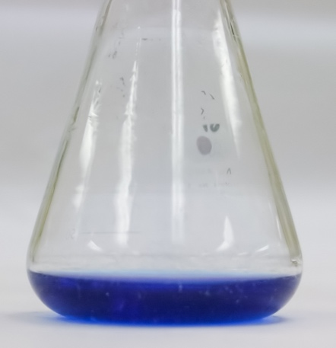
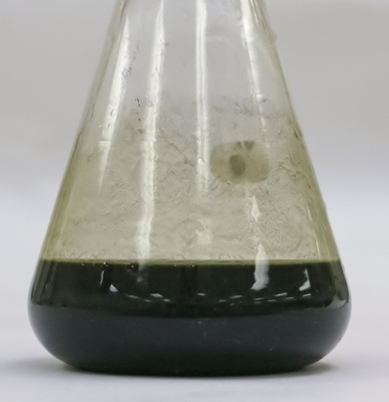
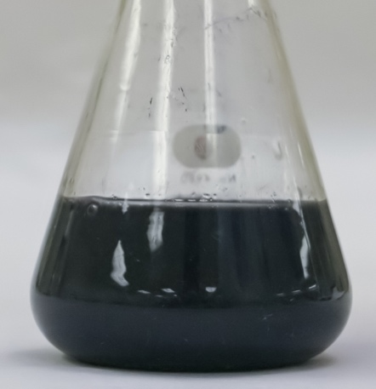
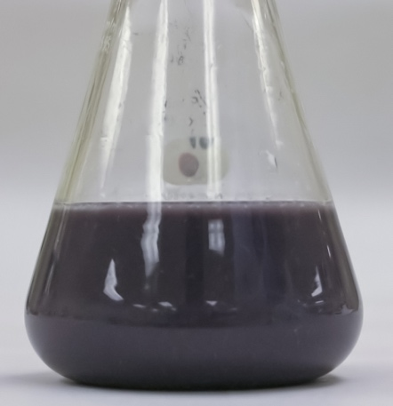
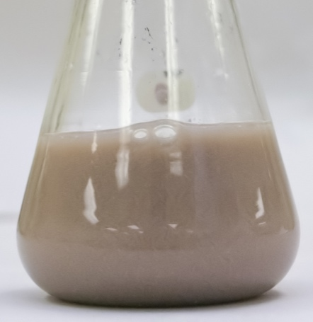
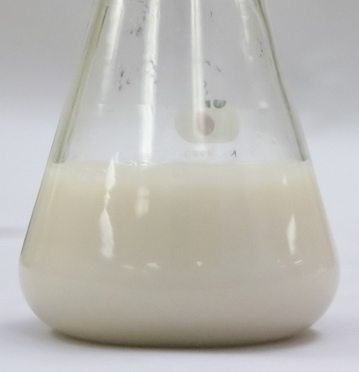
Precautions
Reducing Sugars by Rebelein
Samples must be diluted to fall into an appropriate range for the titration (< 10 g/L total sugar).
Red wine must be decolourised to limit the impact of phenolics and to give a clearer endpoint.
Wines with no fermentable sugars tend to give non zero values around 2g/L.
The starch solution can deteriorate giving a poor endpoint.
Titration with standard thiosulfate solution

Slide 16
Practical application
Reducing Sugar by Lane & Eynon
The wine alcohol is removed by boiling to half volume and decolourised if necessary.
The sample is accurately made up to 100 mL with water.
Mix 10 mL each of Fehlings A and Fehlings B solutions in a 250 ml flask with boiling chips and magnetic stirrer bar.
Bring solution to the boil on a hotplate stirrer.
While boiling titrate with 0.5% w/v glucose solution from a 50 mL burrette. Until a faint blue colour remains.
Add 5 drops of Methylene blue to intensify colour
Continue titration until solution is clear, ignoring the brick red precipitate.
Repeat the titration adding 20 mL of sample at step 3.
Calculated sugar is then, dilution factor/4 x (titre 1 (mL) – titre 2(mL))

Slide 17
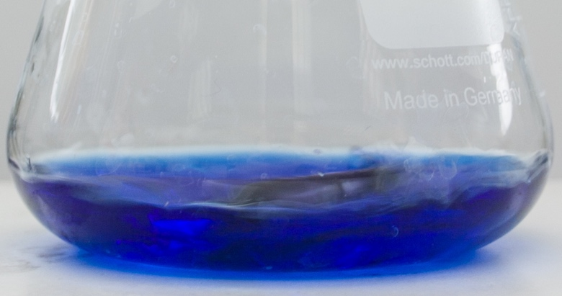
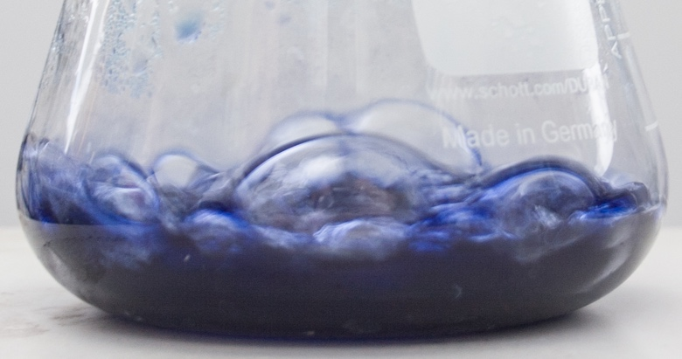
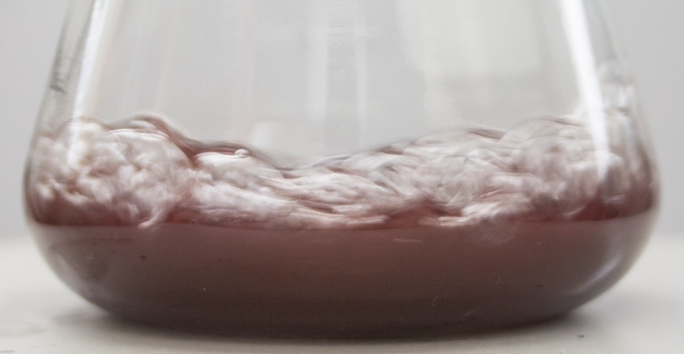
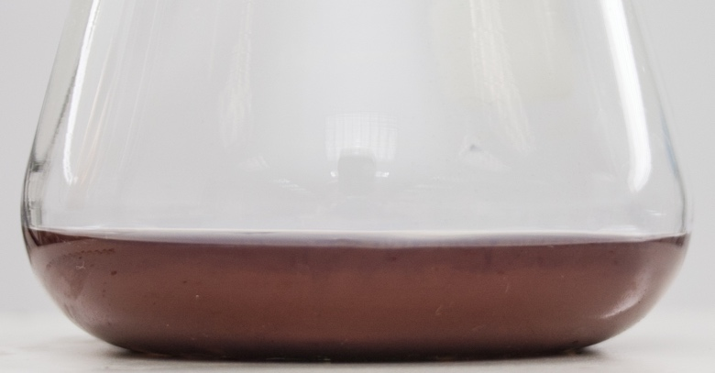
Precautions
Reducing Sugars by Lane & Eynon
It is critical that each titration be done while the solution is gently boiling and should be done over a period as close to 3 minutes as possible.
Samples must be diluted to fall into an appropriate range for the titration (< 4 g/L total sugar).
The endpoint is difficult to determine and should be done through the edge of solution.
Titration with 0.5% w/v glucose

Slide 18
Common issues / interferents
Enzymatic G&F
No major interferents (including colour) but care must be taken to ensure sugar concentration is in the correct range for linear calibration.
Reducing Sugars
Colour compounds, phenolics and other reducable wine component can give erroneously high results.
Regularly see significant differences between analysts.
Care must be taken to ensure samples fall in the correct analytical range.

Slide 19
Quality Control
The first and every 10th sample should be a wine of known sugar.
Duplicate are advisable but should not replace a control wine of matched matrix.
Standard 10 and 1 g/L glucose solution should be made freshly and run at least weekly. Recovery should be better than +/- 5%
For enzymatic testing procedures a calibration curve should be run at least weekly covering the full range of concentrations in scope and including at least 4 non zero sugar concentration.
For reducing sugar methods, a known red wine sample spiked with 2 g/L glucose should be run weekly to ensure recovery and the efficacy of decolourization procedure.

Slide 20
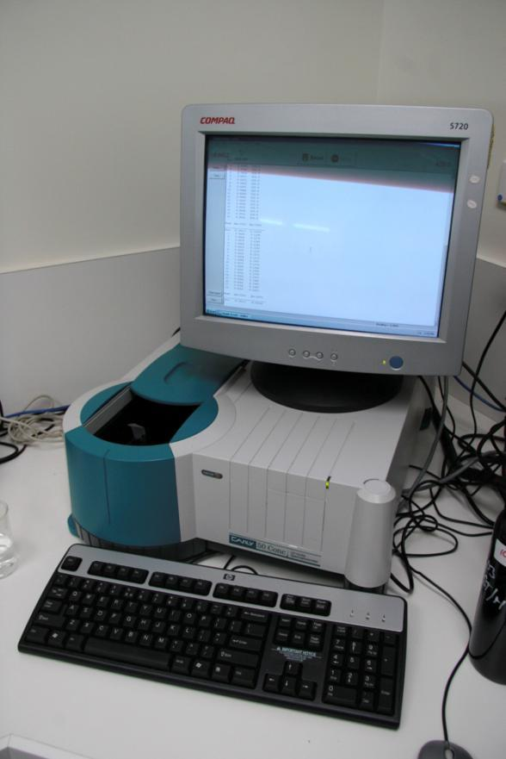
Troubleshooting G&F
One dilution does not suit all wine concentration (avoid non linear calibration curves).
Enzymatic reagents go off in high temperatures and with time, monitor standard response.
Sample temperature can significantly impact results, all solution should be at RT.
The pipetting steps can give huge errors, make sure everyone is using the autopipette in the correct manner.
Do not reuse tips between samples.
Ensure proper mixing post reagent addition.
For large sample groups split into batches, time differences during analysis runs can have an impact.
Regularly check spectro- wavelength and absorbance performance.
Store reagents to prevent contamination and degradation (eg clean plastic / fridge)
Centrifuging or filtering of turbid juice or wine samples can be required to ensure non interference with absorbance.

Slide 21
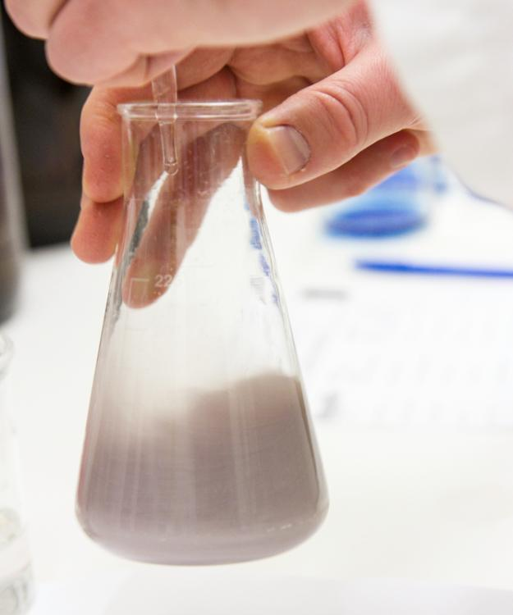
Troubleshooting Rebelein
Sugar solutions have short shelf lives – consider freezing aliquots
Solutions Z1 and Z6 are the most unstable – do your own trials to establish expiry dates for all
Use purified water for all Rebelein solutions
Use plastic stoppers for storage of Rebelein solutions
Decolourising reds is a must – not too much or too little carbon
Ensure boiling chips are used to mix during heating
Allow solution to reach room temp before adding Z3, Z4,Z5
Titration must occur within 3 mins of adding Z3, Z4 and Z5
Missing the cream endpoint – titrate dropwise near endpoint
Calculate 75% of titration volume for higher sugar samples to avoid overshooting titration or exceeding titration time
Air bubbles in burettes (particular hidden ones in digital burettes) leads to titration errors
Invert sugars – is there sucrose in the sample?
Dilutions – samples containing > 20-30 g/L reducing sugars
If using microwave to heat, check solution actually boils and validate heating times required

Slide 22

Troubleshooting Lane & Eynon
Run a standard or known sugar solution with each batch
Sugar solutions have short shelf lives – consider freezing aliquots
Fehlings A and B mix must be freshly prepared
Decolourising reds is a must – not too much or too little carbon
Ensure boiling / titration time for reaction is consistent (3 mins)
Mixing is important during titration – boiling chips or stirrer bars
Missing the brick red endpoint – titrate dropwise near endpoint
Use a white background to help determine the endpoint
Calculate 75% of titration volume for higher sugar samples to avoid overshooting titration or exceeding titration time
Air bubbles in burettes (particular hidden ones in digital burettes) lead to titration errors
Dilutions – samples containing > 4 g/L reducing sugars

