Slide 1

Laboratory Methods Workshop
Titratable Acidity
Dr Eric Wilkes
The Australian Wine Research Institute

Slide 2
1. Chemical Entity
  Titratable acidity (TA) is a measure of the hydrogen ions consumed by a titration with a base to a given pH endpoint (usually 8.2).
  It is an approximation of the “total acidity” which represents the concentration of all the acids present in the wine or juice.
  Total acidity is in general impractical to measure on a production basis and as such titratable acidity is used.
  The main acids in wine are tartaric, malic, lactic, succinic, acetic acids and citric acid.
  The test for TA does not differentiate between the different acids and only provides indication of the sum of all the acid in terms of a defined equivalency of hydrogen ions.
  To ensure consistency CO₂ is removed from the wine before titration so carbonic acid also does not contribute.
  Results tend to vary between 3.5 and 7 g/l of tartaric acid equivalents.

Slide 3
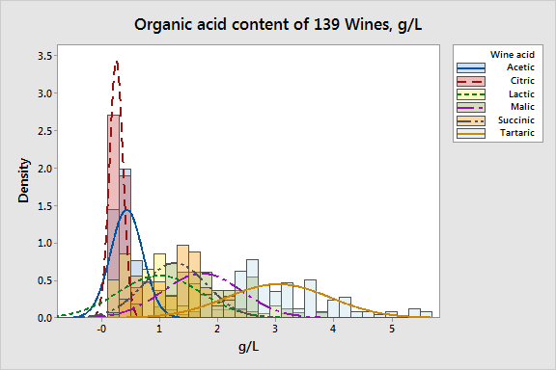
1. Chemical Entity
A complex mixture
The organic acids found in wine have a direct and significant role in the taste, balance, colour and stability of a wine, and represent an integral aspect of the wine style.
Notes:
During the vinification process we see significant changes in the levels of organic acids.
The final levels of each are driven by the initial quantities present, the grape variety, the wine style desired and the various vinification process and yeast used.

Slide 4
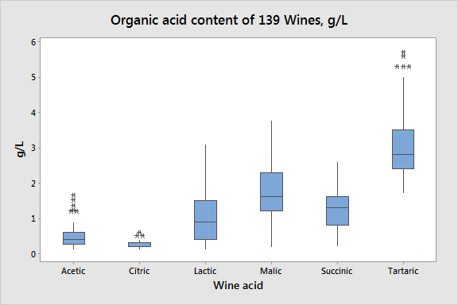
1. Chemical Entity
No simple relationship
The variation in organic acid content between wines is significant and represents a complex interplay between environmental and stylistic issues.
Importantly, all these naturally occurring species pose no health related issues at quantities found in wine.
Notes:
The variation in organic acid content between wines is significant and represents a complex interplay between environmental and stylistic issues.
Importantly, all these naturally occurring species pose no health related issues at quantities found in wine.

Slide 5
1. Chemical entity
Traditionally TA was determined with indicators such as phenolphthalein assuming.
With the advent of pH meters an endpoint of pH 7.0 was used. Titration to this endpoint is still commonly used in Europe.
However with an increased understanding of the complex mixture of weak acids in the wine matrix a shift to higher endpoints was adopted in many economies.
Today an endpoint of pH 8.2 is generally considered the standard at which all wine acids have reacted with NaOH and gives the best indication of the amount of organic acids present in the wine.
This standard has been adopted by the majority of economies outside of Europe.
Because the TA represents a non constant mix of acidic species it is not possible to covert between TAs measured at pH7.0 and 8.2.

Slide 6
1. Chemical entity
Traditionally TA was determined with indicators such as phenolphthalein assuming.
With the advent of pH meters an endpoint of pH 7.0 was used. Titration to this endpoint is still commonly used in Europe.
However with an increased understanding of the complex mixture of week acids in the wine matrix a shift to higher endpoints was adopted in many economies.
Today an endpoint of pH 8.2 is generally considered the standard at which all wine acids have reacted with NaOH and gives the best indication of the amount of organic acids present in the wine.
This standard has been adopted by the majority of economies outside of Europe.
Because the TA represents a non constant mix of acidic species it is not possible to covert between TAs measured at pH7.0 and 8.2.

Slide 7
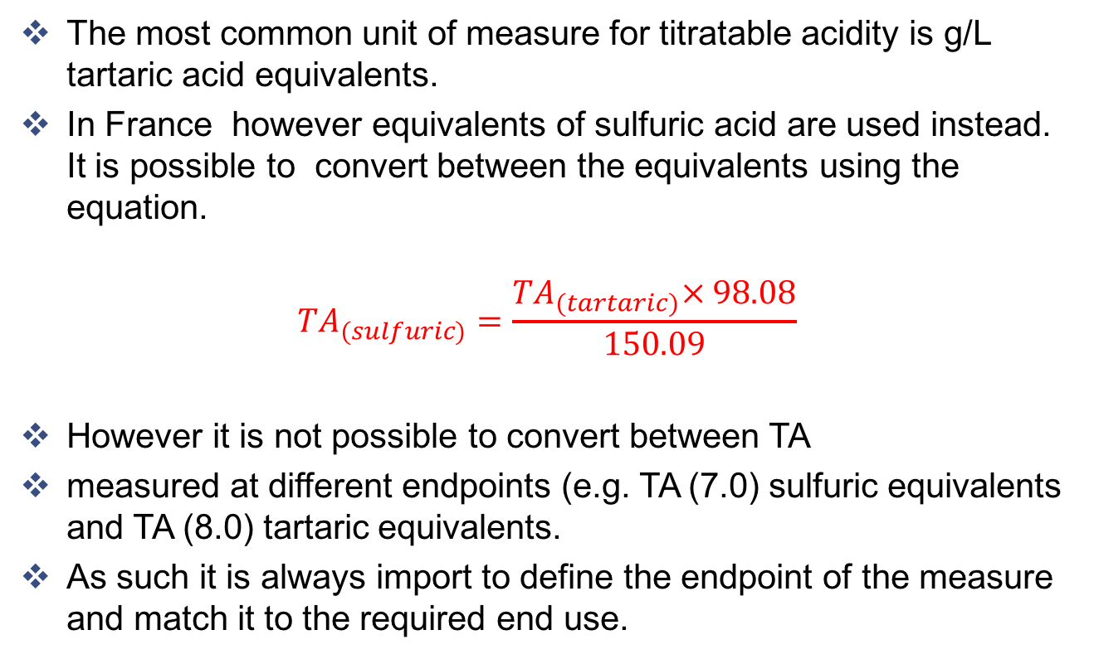
2. Units of measurement
The most common unit of measure for titratable acidity is g/L tartaric acid equivalents.
In France however equivalents of sulfuric acid are used instead. It is possible to convert between the equivalents using the equation.
$${TA}_{(sulfuric)}=\frac{{TA}_{(tartaric)}× 98.08}{150.09}$$
However it is not possible to convert between TA
measured at different endpoints (e.g. TA (7.0) sulfuric equivalents and TA (8.0) tartaric equivalents.
As such it is always import to define the endpoint of the measure and match it to the required end use.

Slide 8
3. Limits of measurement
APEC 2015 Ring Test Results
White
Red
Importantly, standard deviations of 0.53 and 0.41 for whites and red respectively

Slide 9
3. Limits of Measurement
2015 Interwinery Results
Round 1 |  |  | Round 2 |  |  | Round 3
n | Ave | SD | n | Ave | SD | n | Ave | SD
144 | 7.58 | 0.20 | 149 | 7.51 | 0.21 | 149 | 7.48 | 0.23
142 | 6.57 | 0.17 | 151 | 6.52 | 0.15 | 151 | 6.52 | 0.16

Slide 10
4. Methodologies
The most common procedure for measuring TA is adding a known amount of a base to the wine until all the acid has been neutralised in a chemical reaction.
  This is done by the slow addition of the base (usually sodium hydroxide, NaOH) while monitoring the pH with either a pH meter or a coloured indicator solution.
  Once the solution reaches a prescribed pH (usually 7.0 or 8.2) it is assumed all the acids in the sample will have been consumed by the base.
  The concentration of the base and the amount added is used to calculate the original amount of acid in the wine.

Slide 11
4. Methodologies
There are a number of ways to perform this procedure, referred to as an acid/base titration.
  A burette and a indicator solution such as phenolphthalein. With care this works well but it can be difficult to pick the correct endpoint in coloured wines and juices.
  A burette and pH probe. This method allows the pH to be constantly monitored during the titration and tends to give a more accurate result. It is this method that which will be described in this presentation.
  An autotitrator. This is an instrument which automates the dosing of the base and monitors the pH, usually reporting the result directly as a g/L tartaric acid.
It is also now possible to use FTIR instruments for generating TA results for both juice and wine in one step. While they can be very effective they need carefull calibration and can be sensitive to the nature of the juice or wine being tested.

Slide 12
Practical application
Sample preparation
Wine
  Centrifuge or filter off any gross solids.
  Degas a 50 ml sample by either stirring in a side arm flask under vacuum for 2 minutes or sparging with nitrogen for 5 minutes. This is necessary to remove any CO₂ in the solution as this will form a weak acid which will interfere with the results.
Juice
  Centrifuge or filter off any gross solids.
  Juice samples do not need to be degassed

Slide 13
Practical application
Titration
Accurately pipette 25 mL of sample into a beaker (ensuring that the beaker is small enough that the sample cover the porous frit on the probe).
Rinse the electrode with water and put it into the sample.
With constant stirring allow the pH to stabilize and then record (this is the pH result)
With constant stirring slowly add NaOH (0.333M) from a burette.
Continue adding until the pH of the solution is at 7.0 and record the titre (T_{7.0}). Continue titrating until ph 8.2 and then record this titre (T_{8.2}). These titres are used to calculate the TA at 7.0 and 8.2 respectively.
Remove the electrode and rinse with clean water.
Store the electrode in either water or KCl as per manufacturers instructions.

Slide 14
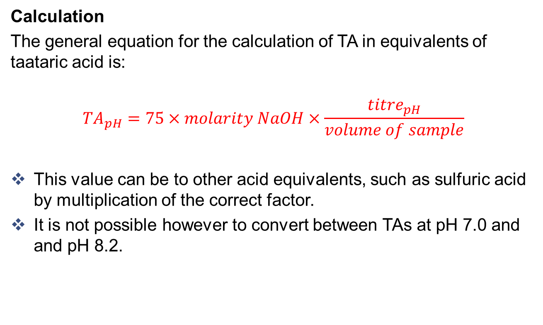
Practical application
Calculation
The general equation for the calculation of TA in equivalents of taataric acid is:
$${TA}_{pH}=75×molarity NaOH×\frac{{titre}_{pH}}{volume of sample}$$
This value can be to other acid equivalents, such as sulfuric acid by multiplication of the correct factor.
It is not possible however to convert between TAs at pH 7.0 and and pH 8.2.

Slide 15
Precautions
Although many pH meters claim to be temperature corrected it is important to do titrations as close as possible to the calibration temperature (20∘C).
Titration accuracy is reliant on pH measurement performance. pH probes must be calibrated and in good condition to ensure accurate titrations.
Ensure that NaOH solutions have been recently standardised and are protected from reaction with atmospheric CO₂.

Slide 16
Common issues / interferents
By far the most common interferent in TA measurement is CO₂. It is important that the sample be suitably degassed before analysis.
It also important that the degassing process not be so vigorous that it also removes a portion of any volatile acids such as acetic.
Samples with high solids content can give erroneously high results due to absorption of the base by the solid materials.

Slide 17
Quality control
At the start of each run and for every 10th sample run a known wine or cask sample. Result should not vary by more than 0.1 g/L between samples.
Record the zero point and slope during calibration and monitor for changes.
Monitor the time required for the pH stabilization. Increases will indicate electrode deterioration and will cause inaccurate endpoints.
At least weekly analyse a wine and then repeat the analysis after addition 1 mL of a 25 g/L Tartaric acid solution to the sample aliquot. The difference between results should be 1 g/L.

Slide 18
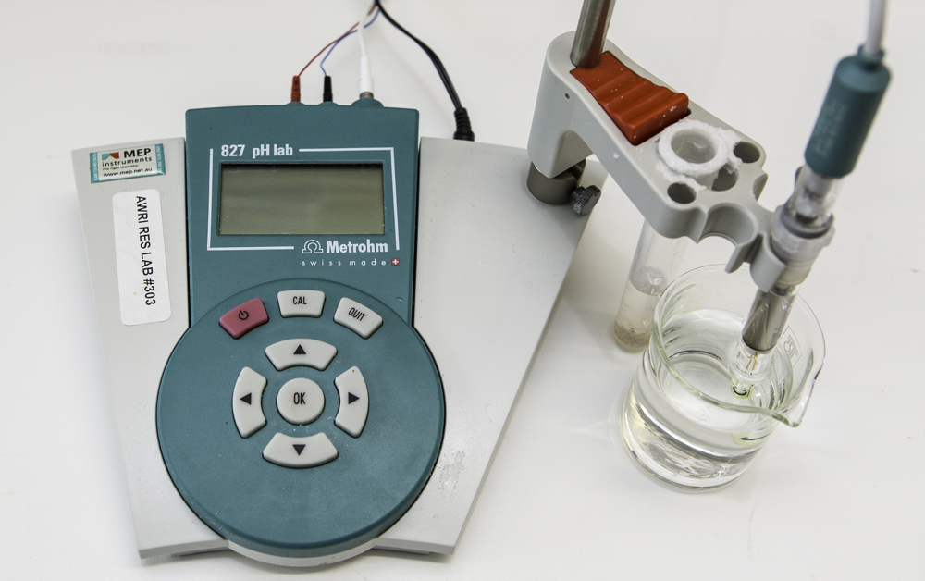
Troubleshooting
Don’t reuse buffers, cross contamination ruins them.
Calibrate as close to 20C as possible.
Temperature correction does not adjust for the sample, titrate at 20 deg always.
You can dilute your sample volume, but only for TA not for pH.
Porous frits often block in juice and wine over time! Fast flow junctions are required.
Fast flow junctions rapidly run out of electrolyte.
Pay attention to the zero point and slope (graph them).
Pay attention to the stabilization time (set a limit).
For autotitrators, slow stabilization can lead to missed end points.

Slide 19
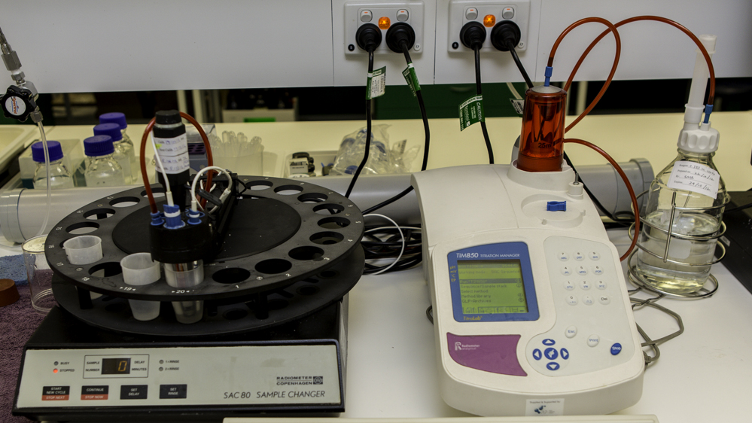
Troubleshooting
Use a tartarate solution for a QA check, not HCl.
Always run a standard addition sample to check performance.
Carbonate build up (the white powdery stuff) damages the mechanics of autotitrators and syringes.
NaOH deteriorates through interaction with atmospheric CO2. Standardise regularly.
Use a lime trap on the NaOH reservoir.
Never trust premade solutions!
Improper degassing causes some of the biggest errors (validate you method).
Don’t leave the electrode storage plug in when in use.
Clarify juice samples by centrifuging if necessary.
Be diligent with electrode cleaning during vintage to avoid protein build up.

