Slide 1

Laboratory Methods Workshop
Total Sulfur Dioxide
Dr Eric Wilkes
The Australian Wine Research Institute

Slide 2
1. Chemical entity
Sulfur dioxide (SO₂) is both added to grapes and wine and also produced by yeasts during fermentation.
It has a dual role as an antimicrobial and antioxidant in finished wines.
SO₂ once added to wine exist in a number of equilibrium forms.

Slide 3
1. Chemical entity
In solution it exists in 3 main forms in equilibrium
SO₂
Molecular
+ H₂0
HSO₃⁻ + H⁺
Bisulfite
SO₃²⁻ + 2H⁺
sulfite
92~99%
80
60
40
20
0
0
2
4
6
8
10
pH
Notes:
At wine pH the bisulfite form dominates 92~99%

Slide 4
1. Chemical entity
These forms also interact with other wine components.
The bisulfite anion reacts with carbonyls, particularly acetaldehyde
free
bound
SO₂ HSO₃⁻ SO₃²⁻
SO₂ bound to phenolics, colour, sugars
SO₂ bound to acetaldehyde
SO₂ HSO₃⁻ SO₃²⁻
SO₂ bound to acetaldehyde, phenolics, colour, sugars
total
Notes:
We talk about
free (unbound SO₂ and HCO₃⁻)
bound (carbonyl and other bound species)
total (free and bound added)

Slide 5
2. Units of measurement
The main measurement of interest in most regulatory systems is total SO₂ (TSO₂).
This includes the summation of all forms of SO₂ present including bound and unbound forms.
In most economies which regulate TSO₂ it is expressed in terms of mg/L of the wine.

Slide 6
3. Limits of measurement
APEC 2015 Ring Test Results
White
Red
Importantly, standard deviations of 19 and 36 for whites and red respectively

Slide 7
3. Limits of measurement
2015 Interwinery Results
Round 1 |  |  | Round 2 |  |  | Round 3
n | Ave | SD | n | Ave | SD | n | Ave | SD
136 | 147 | 6.3 | 138 | 145 | 6.6 | 137 | 143 | 5.0
134 | 63 | 4.0 | 140 | 59 | 4.3 | 138 | 56 | 5.0

Slide 8
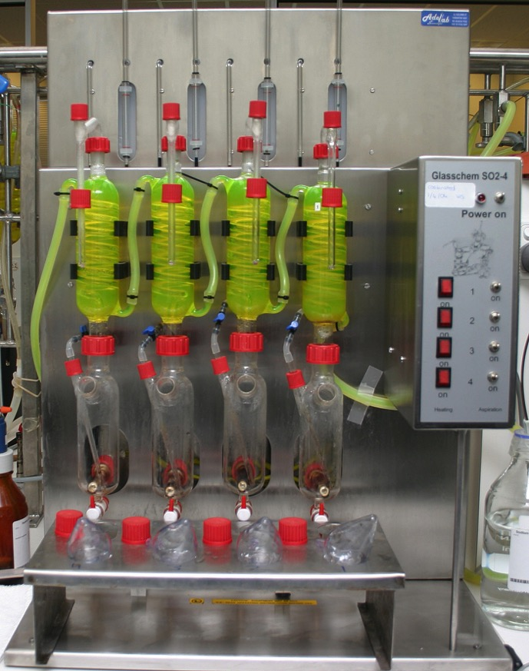
4. Methodologies
Four common methods
aeration / oxidation
Ripper
flow analysis
enzymatic
Notes:
There are others but they are not common enough to cover here

Slide 9
4. Methodologies
Aeration / oxidation (also known as Monier/Williams or Rankine) is generally considered the reference method and is least prone to interference by wine components for TSO₂.
Ripper (or iodic titration) is also commonly used but suffers from phenolic interference.
The other methods while well developed are not as commonly used and generally referenced against the first two methods.

Slide 10
Practical application (A/O)
Basic Principles
Acidify sample to drive free to molecular form.
Pass a stream of air through the heated (not boiled) liquid to carry the SO₂ up through a condenser (more about that later) into a solution of hydrogen peroxide and indicator.
H₂O₂ + SO₂ ➔ H₂SO₄
Titrate the acid generated with sodium hydroxide.
Calculate the original amount of SO₂
The condenser prevents volatile acids making their way over to the H₂O₂

Slide 11
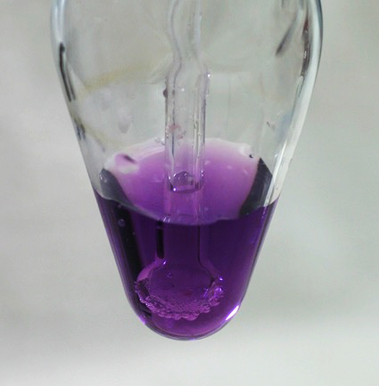
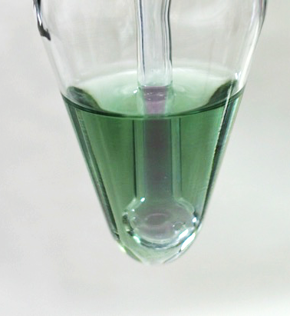
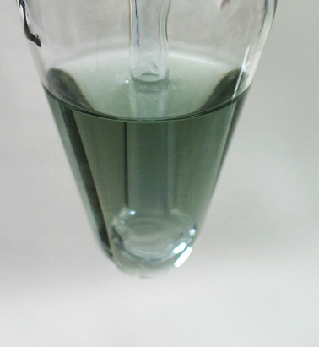
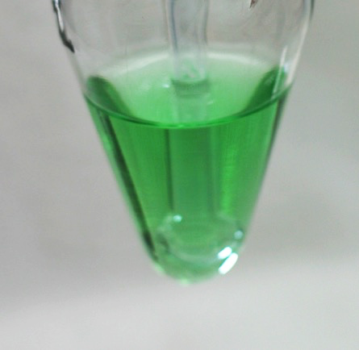
Practical application (A/O)
Titration endpoint
✓
Titration with 0.01M NaOH

Slide 12
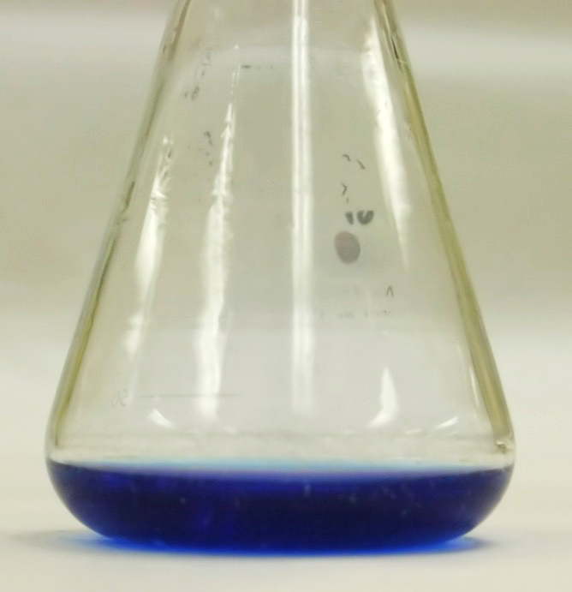
Practical application (Ripper)
Basic principles
A 20 mL sample is placed in a flask with 25 mL of NaOH (1M) and left to equilbrate (10 Minutes).
Vitex indicator added (detect unreacted iodine).
10 mL of 25% v/v H₂SO₄ is used to acidify sample.
NaHCO₃ is added to form a CO₂ blanket to stop O₂ interference.
The sample is titrated with a standard iodine solution until a blue colour.
HSO₃- +I₃⁻ + H₂O ➔ SO₄²⁻ + 3H⁺ + 3I⁻
Calculate SO₂ based on iodine used.

Slide 13
Common issues / interferents
Aeration / Oxidation
No significant interferents, although very high volatile acidity can reduce accuracy.
Incorrect carrier gas or heating can lead to both high and low results dependent on situation.

Slide 14
Common issues / interferents
Ripper
Interference by phenolics, sugars, aldehydes and other reducing substances.
Cannot be used in wines containing ascorbic or erythorbic as these react quantitatively with the iodine.
Endpoint is difficult in red wine.
Method is generally considered less accurate than AO due to interferents in wine.

Slide 15
Quality control
The first and every 10th sample should be a wine of known TSO₂.
Duplicate are advisable but should not replace a control wine of matched matrix.
A standard 100 mg/L TSO₂ solution should be made freshly and run at least weekly. Recovery should be better than +/- 5%
A 1 g/L acetic acid solution should be run at least once a week with no more than 1 mg/L of calculated TSO₂ apparent (not applicable to Ripper).

Slide 16
Precautions (AO)
Regularly check gas flow rates.
Initial sample temperature should be 20∘C +/-5.
Samples should not have H3PO4 added until immediately before aspiration.
Samples should not be left open for any extended period of time.
Peroxide solution should be made up regularly.

Slide 17
Troubleshooting (AO)
Peroxide solutions go off in heat and light.
Poor quality water gives poor indicator colour and degrades peroxide
Putting the indicator in your peroxide supply will make it deteriorate more quickly
NaOH solutions do change with time (re-standardise)
Temperature is important. Excessive vacuum grease absorbs SO₂.
Residue detergent can react with SO₂.
Positive pressure systems can leak but are easy to balance gas flows.
Vacuum systems don’t leak, but are much harder to balance gas flow.

Slide 18
Troubleshooting (AO)
Air bubbles in burettes (particular hidden ones in digital burettes) leads to titration errors
High gas rates and boiling solutions can carry over droplets of wine and VA giving false highs.
Low gas flow leads to low results.
Adding orthophosphoric acid too soon before aspirating can lead to low results.
Blowing through the bubbler tube can dissolve carbonic acid leading to end-point changes.
Target an endpoint that is repeatable.
Dripping wine and juice can stuff up Bunsen's.

