Slide 1
Enhanced Risk Control Working Group
Dr Eric Wilkes

Slide 2
Enhanced Risk Controls- Activities
2016 Ring Test Program
Laboratory Method Quality Workshop
Work Plan going forward

Slide 3
2016 Ring Test Program
Aims
To evaluate the performance of laboratories involved in wine regulatory testing.
Identify issues with inter-laboratory performance
Provide a mechanism for the continuing alignment of methods and capabilities in laboratories testing wine in the international market place.
This program is following on from the successful pilot program which we ran in 2015.

Slide 4
The program
Run in conjunction with the Interwinery Analysis Group. A proficiency testing group specialising in wine laboratory testing with over 200 members around the world.
The APEC WRF ring test consists of participating laboratories testing 12 bottles of wine in 4 time windows (6 reds and 6 whites).
The laboratories have been asked to test the wines for a range of analytes (alcohol, total SO₂, titratable acidity, reducing sugars, glucose + fructose, methanol, copper, iron and manganese).
Laboratories were asked to only submit results for analytes that they routinely test.
Results are assessed both internally within the group and in comparison to the same testing done by the larger Interwinery Analysis Group membership.
Currently 2 of the 4 rounds of testing have been completed.

Slide 5
Participation
20 laboratories were nominated by 12 economies (Australia(2), New Zealand(2), Hong Kong(1), Indonesia(2), Vietnam(2), PNG(2), USA(2), China(2), Russia(2), Chile(1), Peru(1) and Japan(1)).
Samples were provided to 15 laboratories.
It proved impossible to ship wine into two of the economies because of import restrictions.
One economy did not respond to email requests to confirm shipping details.
One economy responded too late to receive samples this year.
Of the 15 laboratories who received samples 13 provided results in the first round.

Slide 6
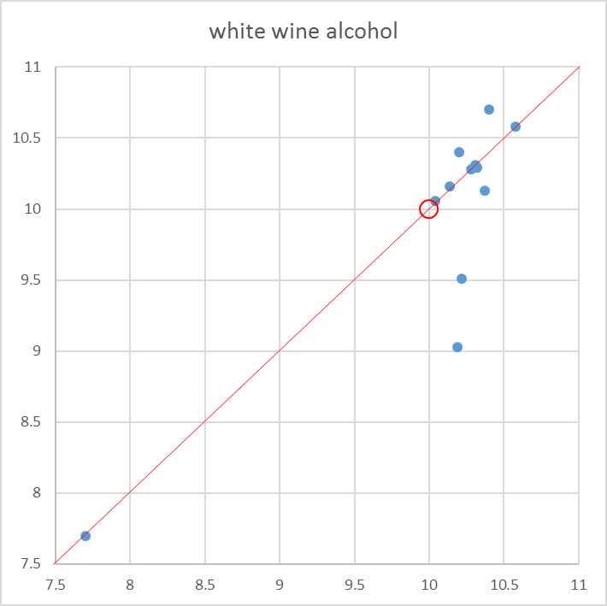
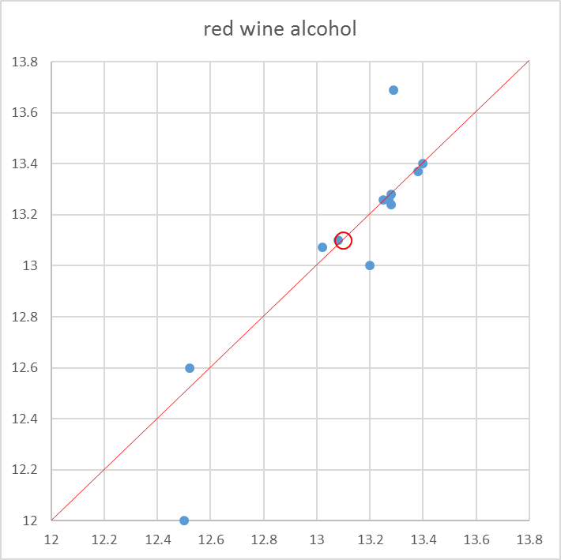
Alcohol
 | White |  | Red
 | APEC | IWAG | APEC | IWAG
Mean | 10.00 | 10.27 | 13.11 | 13.28
Standard Deviation | 0.78 | 0.15 | 0.37 | 0.13
Range 3%
Range 1.7%
IWAG
IWAG
APEC
APEC

Slide 7
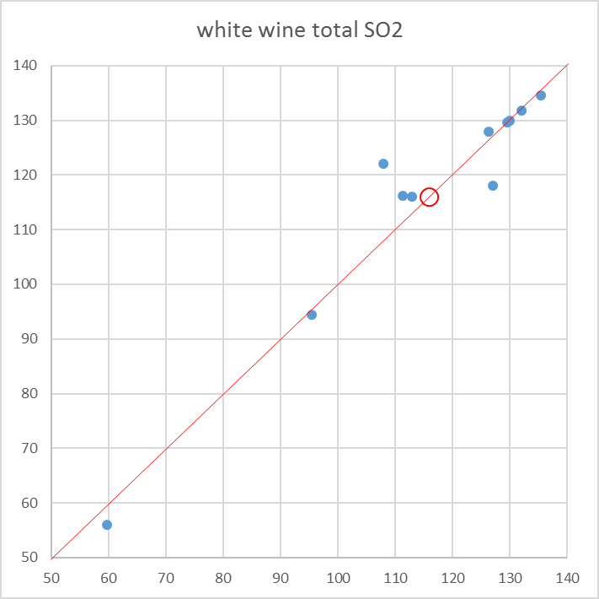
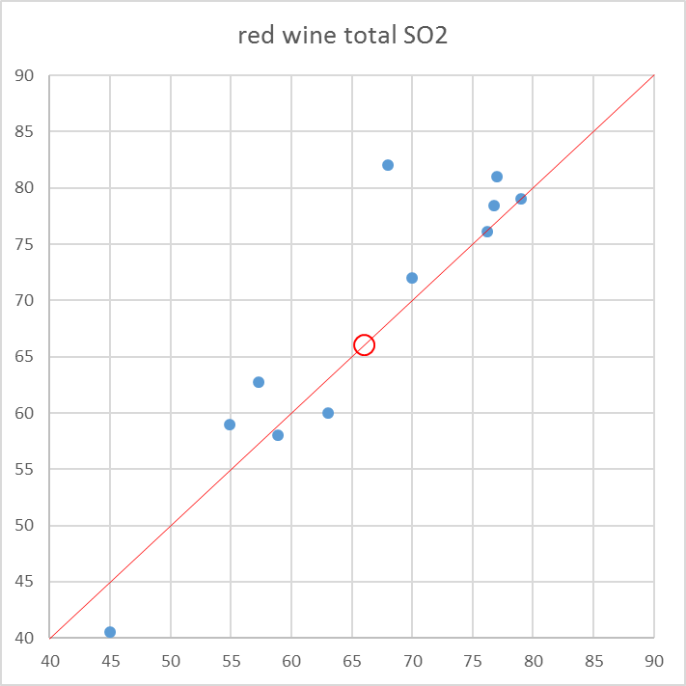
Total Sulfur Dioxide
 | White |  | Red
 | APEC | IWAG | APEC | IWAG
Mean | 115.66 | 125 | 67.03 | 63
Standard Deviation | 21.99 | 6 | 11.87 | 5
Range 80 mg/L
Range 42 mg/L
IWAG
IWAG
APEC
APEC

Slide 8
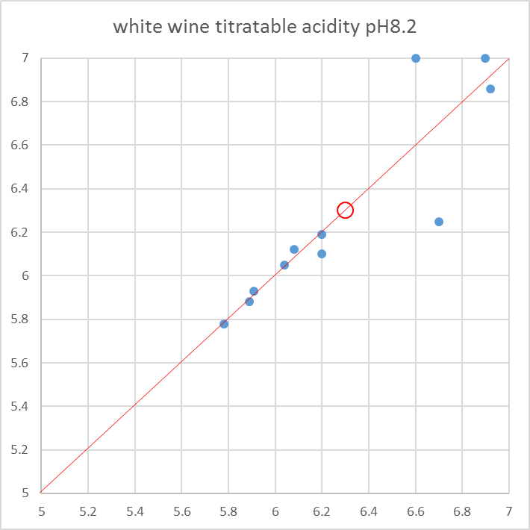
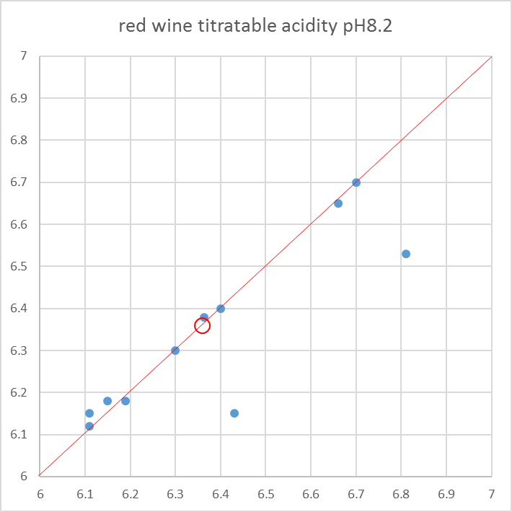
Titratable Acidity (pH8.2)
 | White |  | Red
 | APEC | IWAG | APEC | IWAG
Mean | 6.29 | 6.04 | 6.36 | 6.19
Standard Deviation | 0.42 | 0.35 | 0.22 | 0.17
Range 1.2 g/L
Range 0.7 g/L
IWAG
IWAG
APEC
APEC

Slide 9
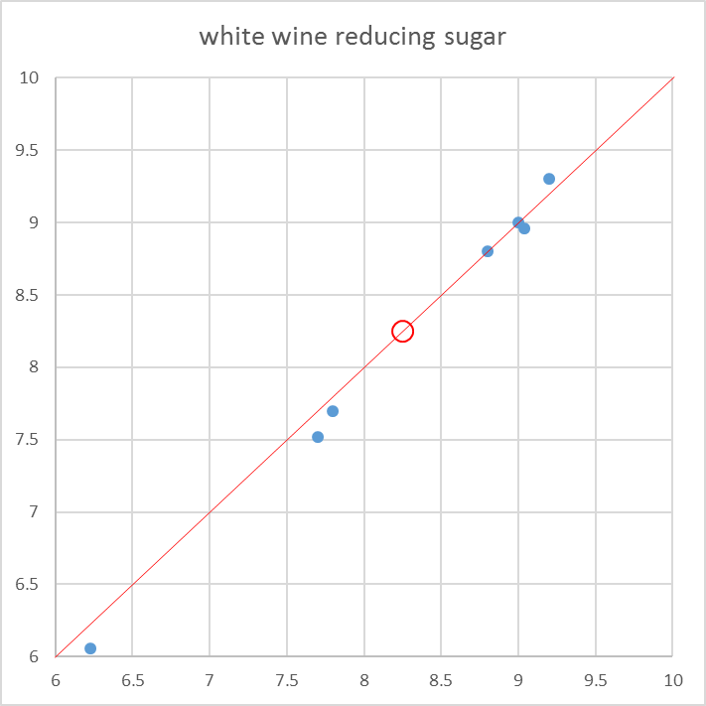
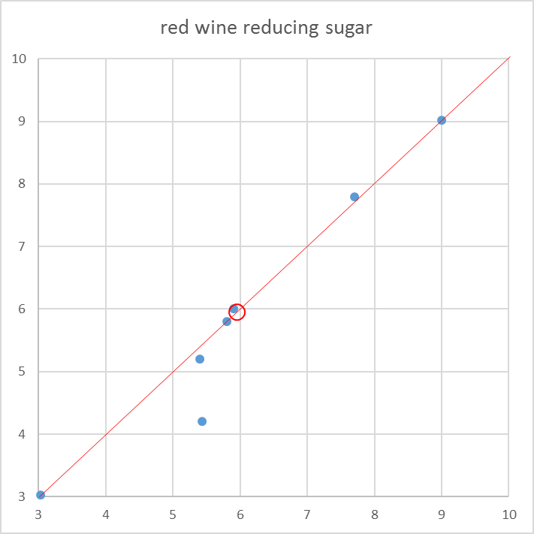
Reducing Sugar
 | White |  | Red
 | APEC | IWAG | APEC | IWAG
Mean | 8.22 | 9.12 | 5.95 | 5.65
Standard Deviation | 1.08 | 0.52 | 1.89 | 0.54
Range 3.2 g/L
Range 5.6 g/L
IWAG
IWAG
APEC
APEC

Slide 10
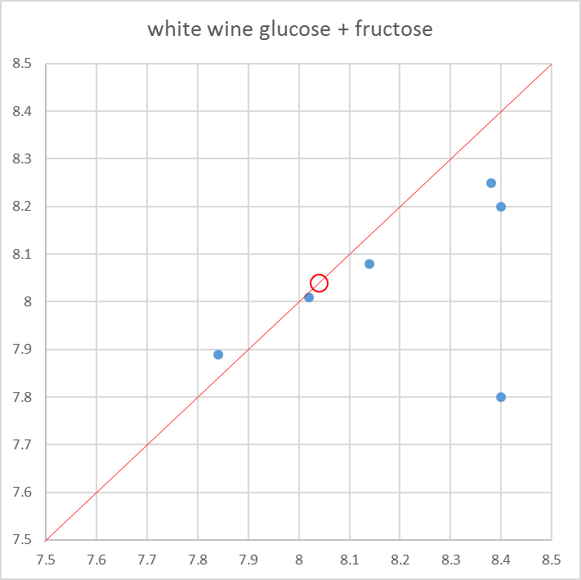
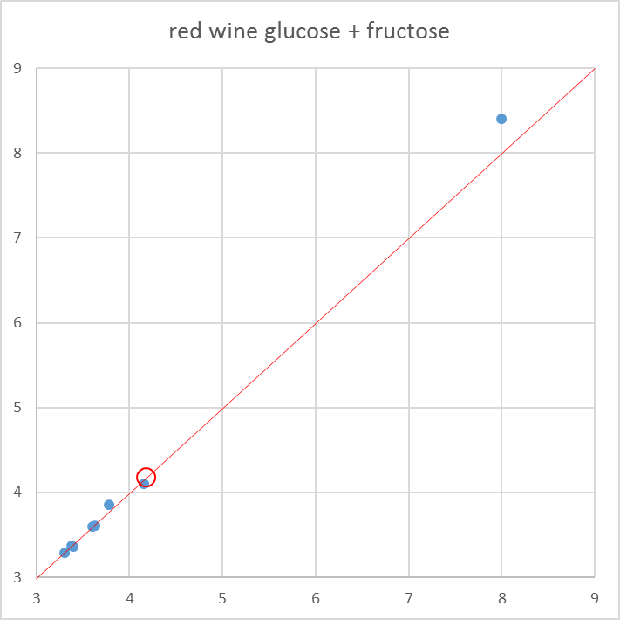
Glucose + Fructose
 | White |  | Red
 | APEC | IWAG | APEC | IWAG
Mean | 8.04 | 7.68 | 4.18 | 3.23
Standard Deviation | 0.24 | 1.01 | 1.59 | 0.71
Range 0.8 g/L
Range 5.1 g/L
APEC
IWAG
APEC

Slide 11
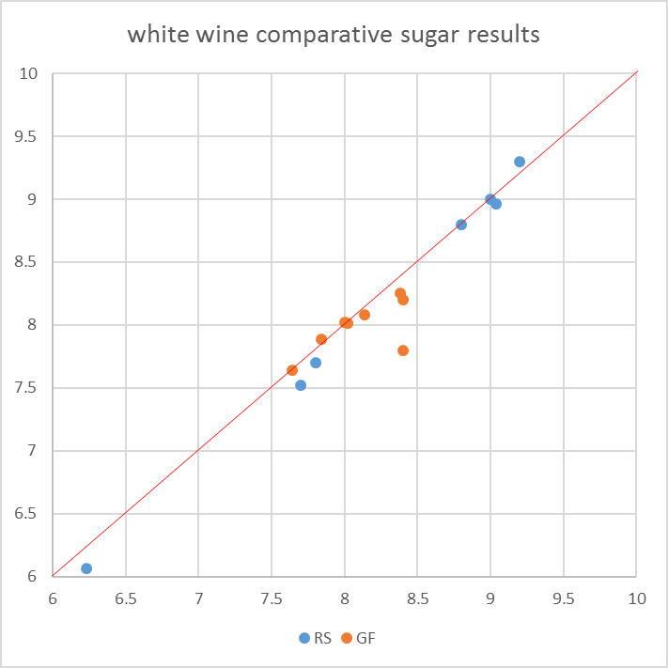
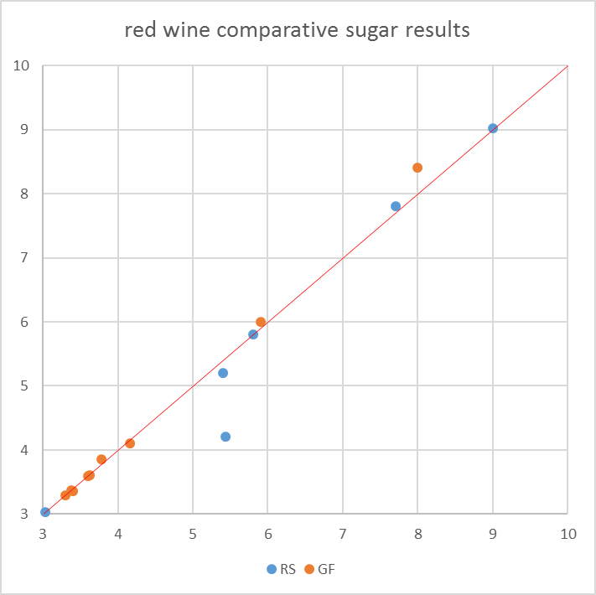
Combined Sugars

Slide 12
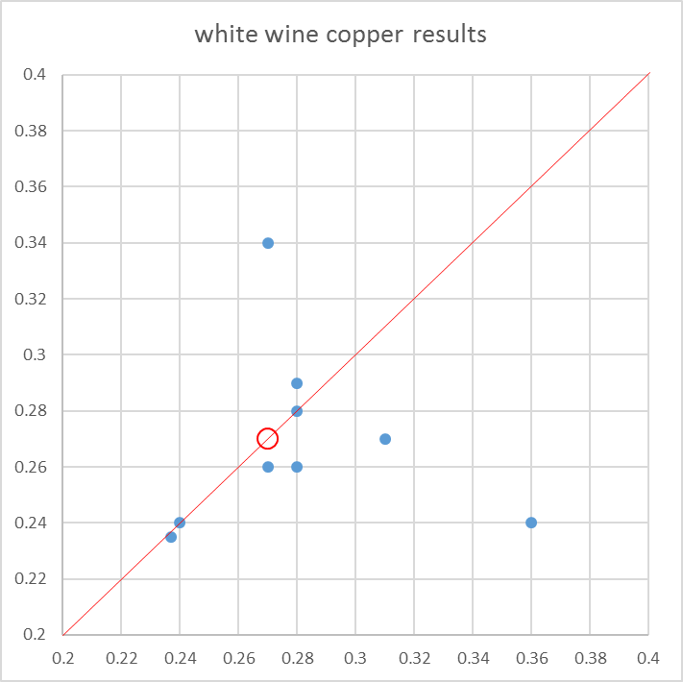
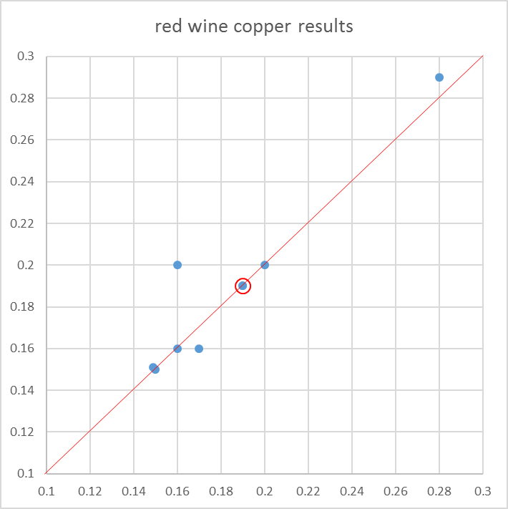
Copper
 | White |  | Red
 | APEC | IWAG | APEC | IWAG
Mean | 0.27 | 0.25 | 0.19 | 0.16
Standard Deviation | 0.03 | 0.05 | 0.04 | 0.03
Range 0.13 mg/L
Range 0.14 mg/L
IWAG
IWAG
APEC
APEC

Slide 13
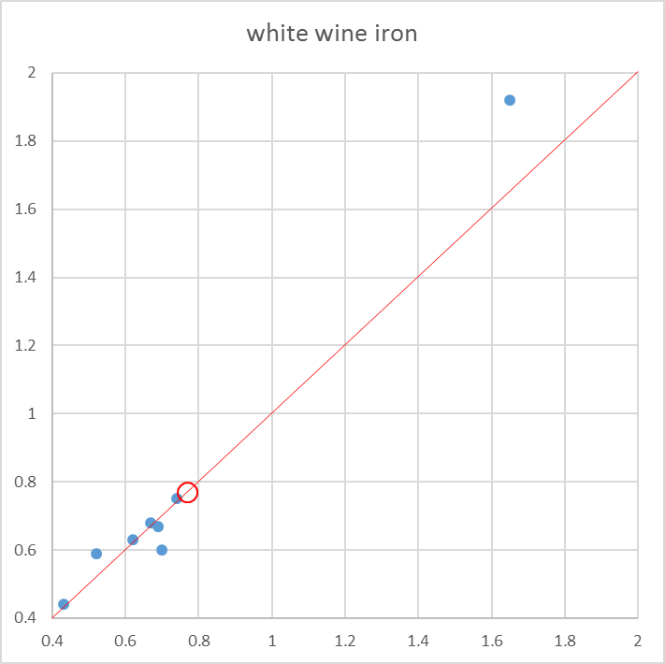
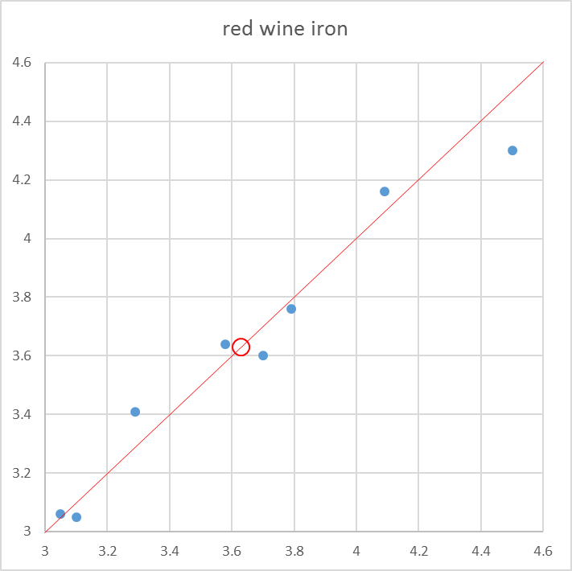
Iron
 | White |  | Red
 | APEC | IWAG | APEC | IWAG
Mean | 0.77 | 0.7 | 3.63 | 3.66
Standard Deviation | 0.41 | 0.11 | 0.46 | 0.32
APEC
APEC
IWAG
IWAG
Range 1.5 mg/L
Range 1.5 mg/L

Slide 14
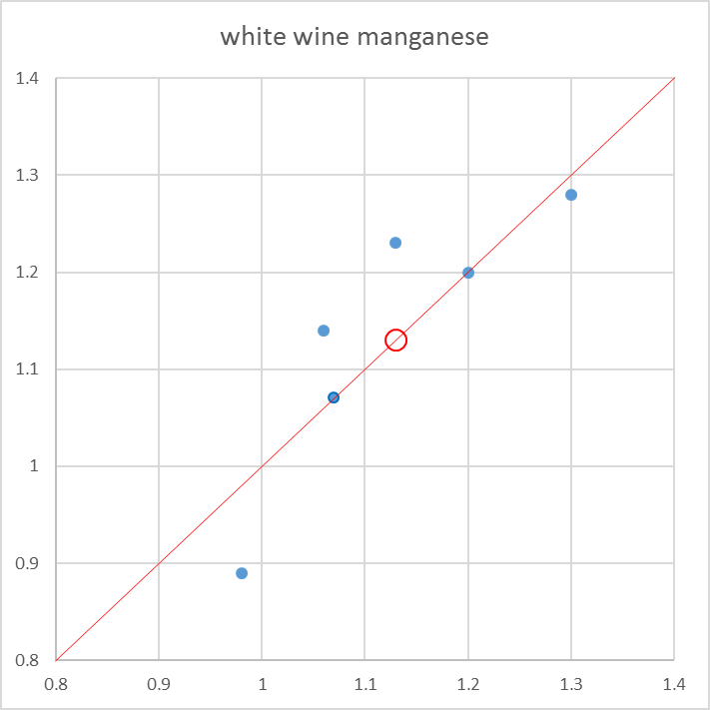
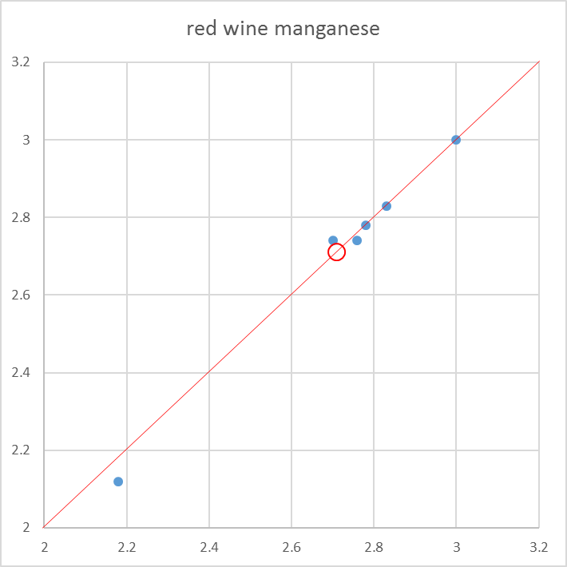
Manganese
 | White |  | Red
 | APEC | IWAG | APEC | IWAG
Mean | 1.13 | 1.05 | 2.71 | 2.7
Standard Deviation | 0.12 | 0.09 | 0.28 | 0.25
Range 0.41 mg/L
Range 0.88 mg/L
IWAG
IWAG
APEC
APEC

Slide 15
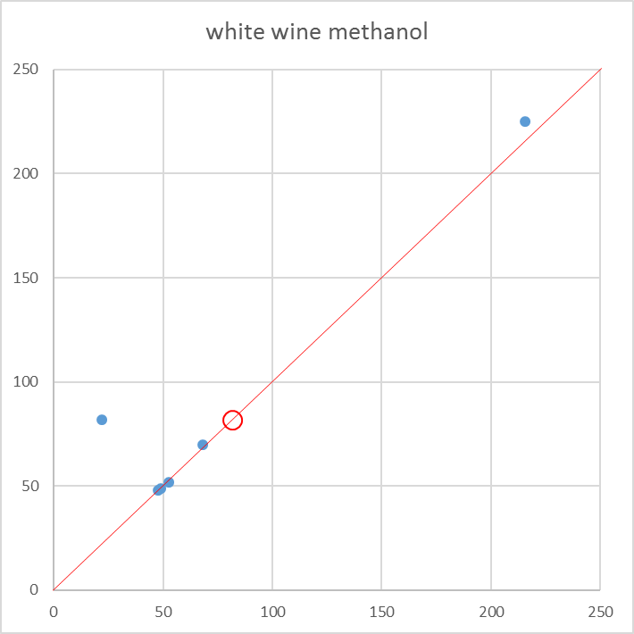
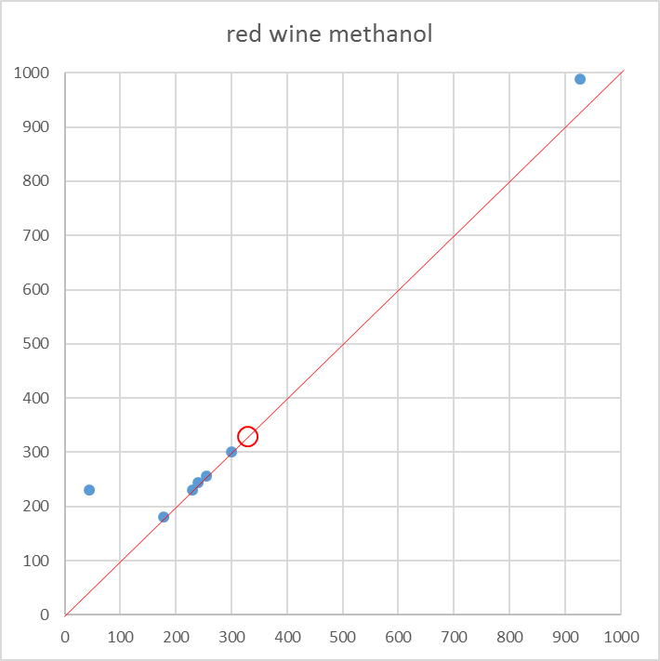
Methanol
 | White |  | Red
 | APEC | IWAG | APEC | IWAG
Mean | 81.69 | 55.4 | 328.97 | 244
Standard Deviation | 66.38 | 7 | 273.77 | 14
APEC
APEC
Range 203 mg/L
Range 944 mg/L

Slide 16
Summary of Program Results
Still issues with getting samples to some economies.
In general the distribution of results is much greater for the APEC laboratories than it is for the winery specialist laboratories participating in the IWAG program.
This suggest a much lower consistency of results between these laboratories.
Mean results from these laboratories in many cases are significantly different from those found by the IWAG group.
In some cases the level of variation between laboratories is greater than the proposed limits on the analyte.

Slide 17
Laboratory Methods Workshop
A workshop/tutorial covering the best practice for methodology for 4 common wine analytes was held prior to the International Wine Technical Summit in San Luis Obispo in May 2016.
Analytes discussed were alcohol, sulphur dioxide, titratable acidity and sugar.
The workshop covered underlying theory, comparative methods, quality assurance procedures, expected performance and trouble shooting.
The workshop 55 wine regulators, laboratory scientists and wine industry representatives from six of the eight World Wine Trade Group (WWTG) countries and 11 of the 21 Asia Pacific Economic Cooperation (APEC) economies participated in the IWTS.
Each APEC economy attending also received a reference book on wine analysis.
The workshop was videoed for future access and all slide materials are available on the APEC website.

Slide 18
Going Forward
After the next two rounds of testing a consolidated progress report will be supplied to participating laboratories.
It is recommended that the program be continued in its present form for the next two years with expanded participation from APEC economies.
It is suggested that a virtual troubleshooting/support group be formed of participating laboratory staff to discuss strategies for improving laboratory performance and the correlation of results.
This group will meet by teleconference 4 times a year.
If possible the program of laboratory workshops should be repeated with the aim of extending the range of analytes discussed and develop strategies for alignment of laboratory performance.

