Slide 1
Wine in Canada
Dan Paszkowski
Canadian Vintners Association
October 7, 2016

Slide 2
Overview
Wine’s popularity in Canada has risen steadily over the past decade to 31% of all beverage alcohol sales
3rd fastest growing wine market in the world
Outpacing market share growth of all beverage alcohol sales in Canada
Per capita wine consumption in 2015 was 16.6 litres – 6% growth from 15.7 litres in 2010
Wine sales of 475 million litres in 2015, up 42% or 141 million litres over the past decade
77% of wines sales growth from imports
68% of wine sold in Canada is imported; 32% is produced in Canada
Top 5 import countries include: USA, Italy, Australia, France and Chile, representing 75% of total import volume

Slide 3
Canadian Wine Industry: Growth and Quality
Vineyard acreage continues to grow
30,060 acres – 15% growth over the past decade
Winery investment on the rise
Over 600 wineries in Canada – 83% growth rate with more than 300 new wineries opening over the past 10 years
Vintners Quality Alliance (VQA) established in 1999
VQA Ontario and the British Columbia Wine Authority are independent provincial authorities that establish and enforce the provinces’ “appellation of origin” system
Origin – Every VQA wine label shows where the grapes are grown
Quality – VQA enforces winemaking standards and labelling integrity through a rigorous certification program
Authenticity – Every VQA wine is 100% grown and crafted in its province of origin
VQA appellation system has created authentic local award-winning wines in which consumers trust

Slide 4
Liquor Sales System in Canada
Canada’s liquor control system was created almost 90 years ago under the federal Importation of Intoxicating Liquors Act (1928)
12 of 13 provinces and territories continue to operate under a liquor board system
Since 1993, Alberta has operated a privatized alcohol retail system
Liquor Boards oversee the control, distribution and sale of beverage alcohol in their respective jurisdiction
Liquor Boards abide by federal regulations (e.g., health, safety, labelling, etc.)

Slide 5
Canadian Wine Regions on the World Map

Slide 6
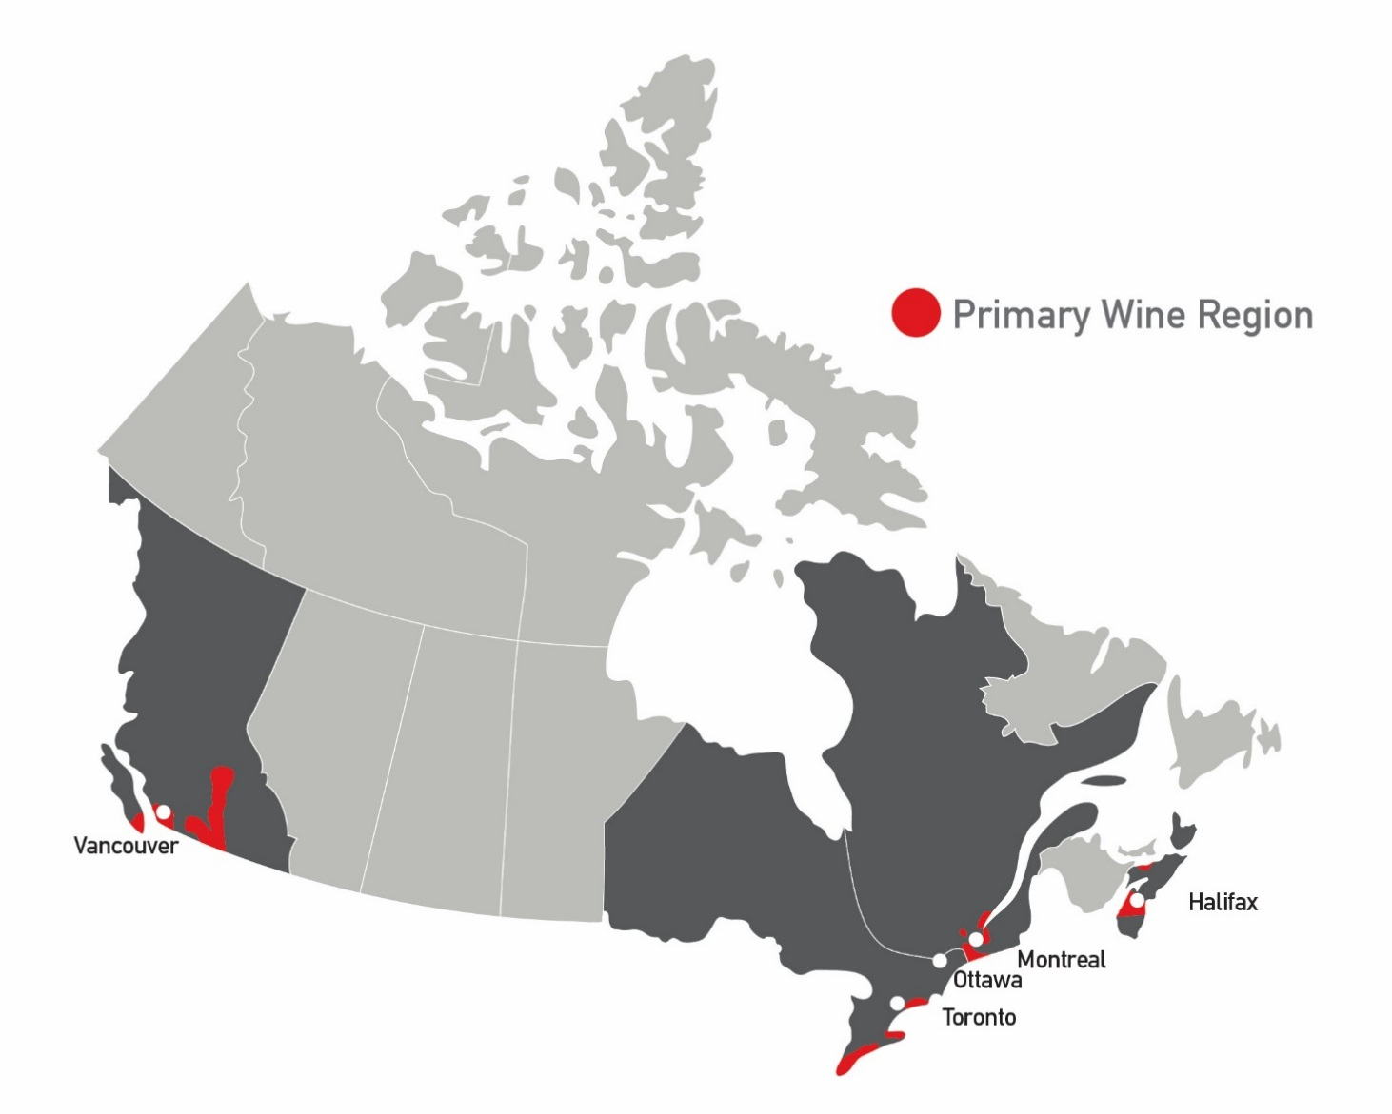
Canada’s Wine Regions
British Columbia 48˚- 51˚
Acres: 10,260 (4,152 Hectares)
Wineries: 260 winebc.com
Nova Scotia 44˚- 46˚
Acres: 800 (323 Hectares)
Wineries: 20 winesofnovascotia.ca
Ontario 41˚- 44˚
Acres: 17,000 (6,900 Hectares)
Wineries: 164 (VQA only) winecountryontario.ca
Quebec 45˚- 47˚
Acres: 2,000 (808 Hectares)
Wineries: 138
viquebec.com

Slide 7
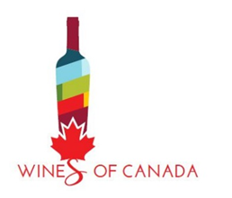
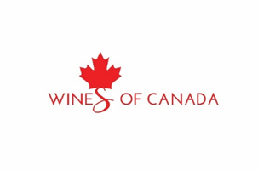
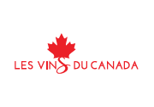
Wines of Canada: Branding
Finalized in late 2015 through comprehensive industry process
Brand essence: Undiscovered Greatness
Three defined attributes:
Pristine made (quality, land, ingredients)
Diversity (regions, culture, people, varietals)
Canadian made, pride of produce

Slide 8
Canadian Wine Export Strategy
Goal is to increase global awareness of Canada as a producer of premium wines
Introduce more Canadian wineries to commercial opportunities/ distribution channels to equip them to export
Currently 10% of Canadian wineries export
Support winery tourism – 3 million visitors to Canadian wineries each year
Enhance market access globally
Focus on target markets -- Top 5 export markets represent 91% of export volume:
China
United States
Japan
Hong Kong
Taiwan

