Slide 1
FIVS- Additives Processing Aids Codex Enology
APEC Wine Regulatory Forum
Ottawa, Canada
6-7 October 2016

Slide 2
What is FIVS-APACE?
FIVS-APACE is a comprehensive online information source for additives and processing aids approved for winemaking use around the world. For each, you will find the following:
Synonyms
INS number,
CAS number,
Functional Class,
Technological justification,
Links to scientific evaluations by Joint FAO/WHO Expert Committee on Food Additives (JECFA) and other expert bodies,
Recommended usage level and
Status of regulatory approval in various markets around the world, including a link to search FIVS-Abridge.

Slide 3
What is FIVS-APACE?
COMING SOON: www.fivs-apace.com or www.fivs-apace.org
Currently has 24 Additives and 61 Processing Aids
Adding 25 substances
Log-In will be required and specifics are being worked out.

Slide 4
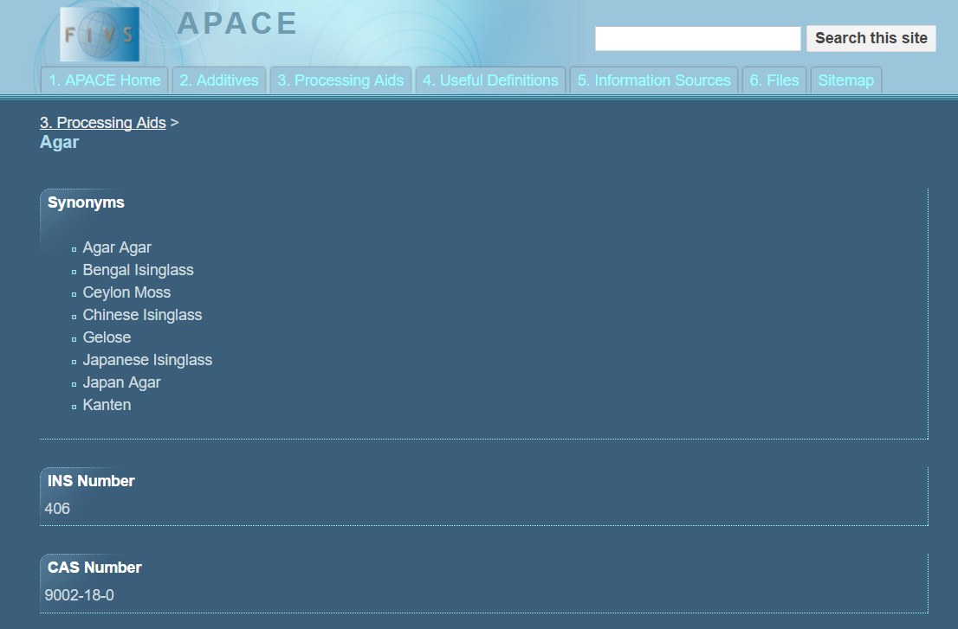
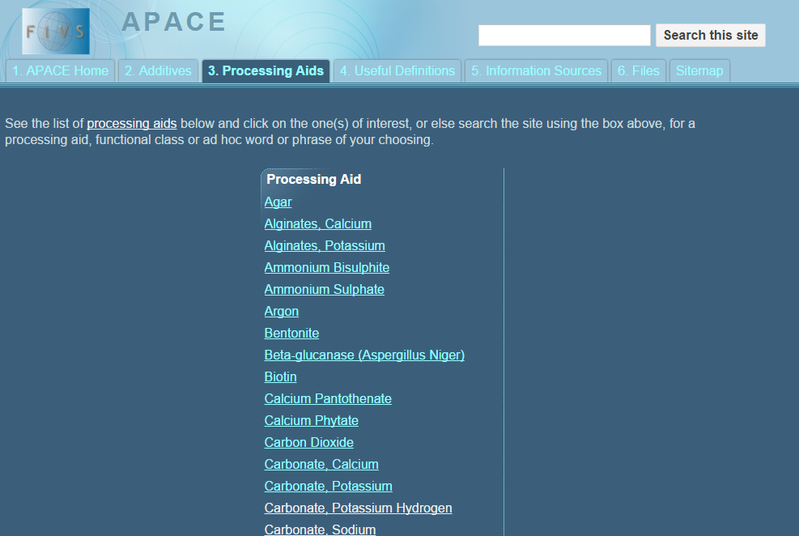

Slide 5
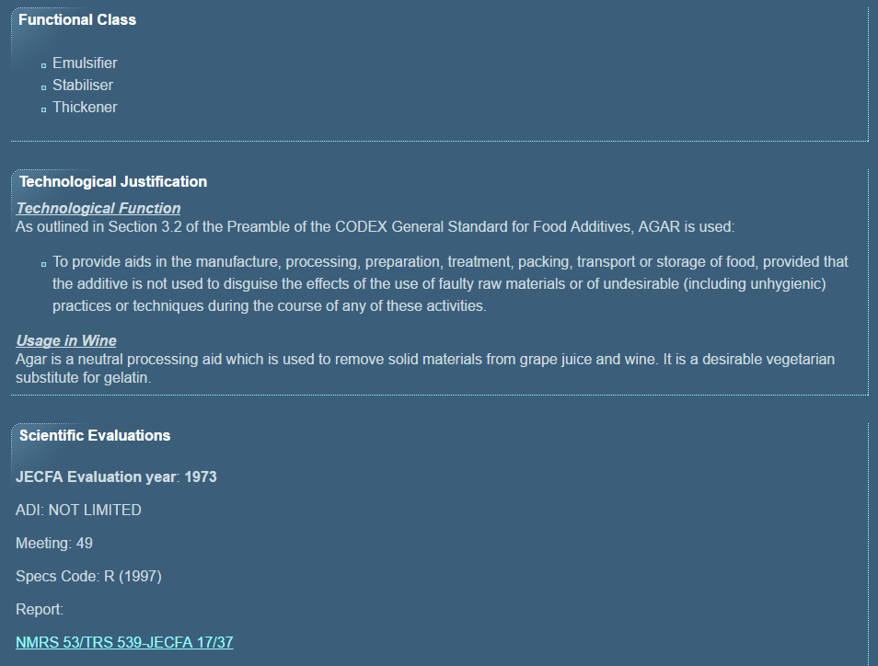

Slide 6
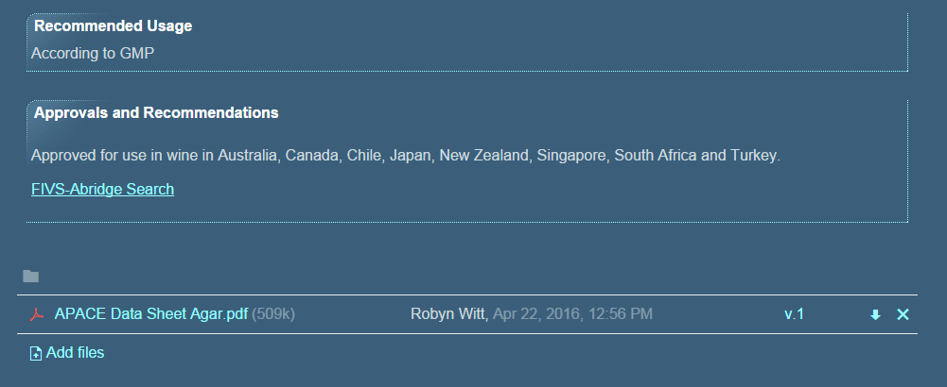

Slide 7
Recommended Usage: GMP
When a JECFA evaluation results in an ADI of "not specified" the level of usage is set as "According to GMP“.
What is Good Manufacturing Practice (GMP)?
Codex:
the quantity of the additive added to food shall be limited to the lowest possible level necessary to accomplish its desired effect;
the quantity of the additive that becomes a component of food as a result of its use in the manufacturing, processing or packaging of a food and which is not intended to accomplish any physical, or other technical effect in the food itself, is reduced to the extent reasonably possible; and,
the additive is prepared and handled in the same way as a food ingredient.

Slide 11
