Slide 1
Substances Permitted for use in Winemaking –A Winemaker’s Story
Paul Huckaba
Analytical Laboratory Manager, Bronco Wine Company
Winemaker, Redwood Vineyards

Slide 2
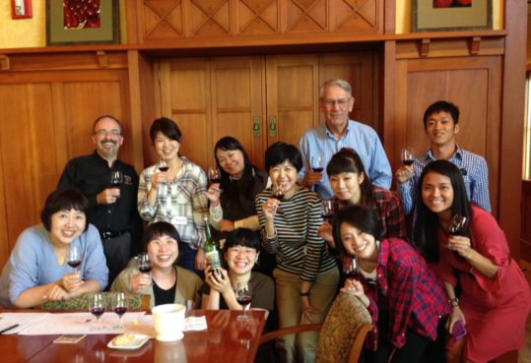
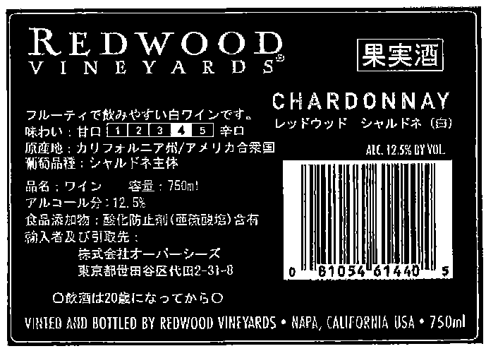
Substances Permitted for use in Winemaking
I am making a wine
I need to think about how to make a good product that my customers will enjoy.
This is a story about how winemaking is affected by Codex Alimentarius, the idea of GMP, 27 CFR 24.246, and other regulations or agreements.

Slide 3
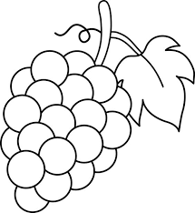
Some interesting facts about Winemaking Substances
Most of the substances used are naturally occurring
Many of them are found in grapes and wine.
Some examples include:
Very few substances do not occur naturally and also remain in the wine to any extent.
Malic Acid | Albumen/Egg White
Lactic Acid | Casein/Milk Products
Citric Acid | Enzymes
Potassium Bitartrate | Granular Cork
Tartaric Acid | Oak Chips
Tannin | Bentonite
Yeast | Isinglass
Sulfur Dioxide | Gelatin

Slide 4
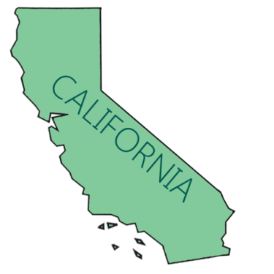
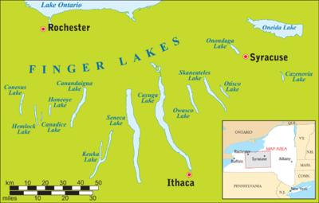
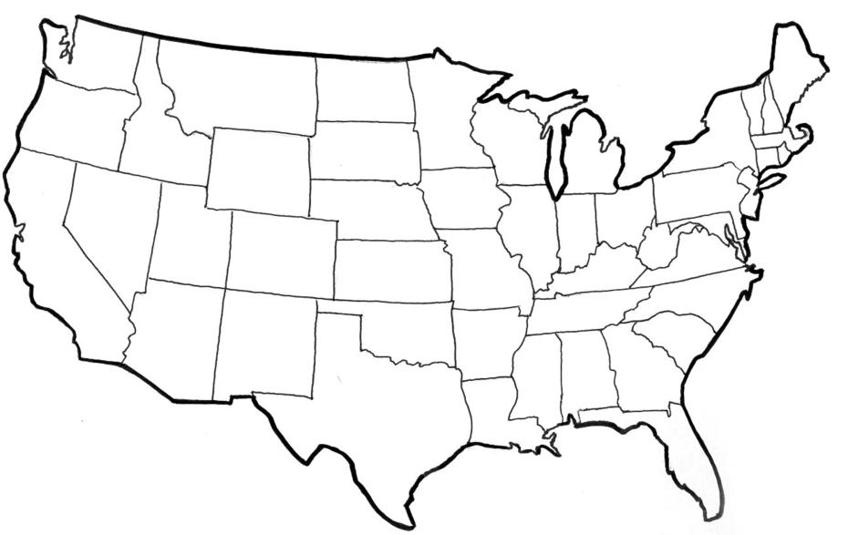
Some interesting facts about Winemaking Substances
The substances that naturally occur in grapes and wine and that are introduced simply to adjust the level of the same substance already present may be a special class of additives and not need labeling. Indeed, to do so could mislead consumers.
Citric acid – If I add it, this doesn’t mean that my wine is always more “acidic” than a wine from a cooler growing area.

Slide 5
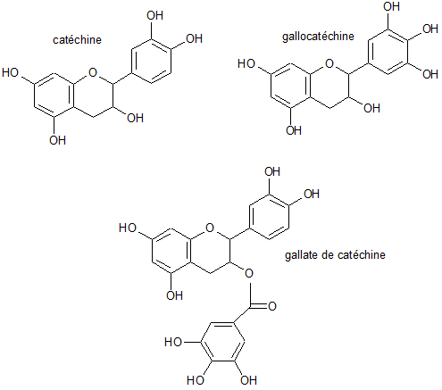
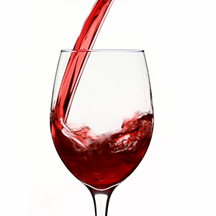
Some interesting facts about Winemaking Substances
There are no chemical or other tests that can be done to determine whether many of the substances permitted for use in winemaking have actually been used (since the identical substances were already present before the addition took place)
Citric acid – If it is added, since it already occurs in grapes and wine, it is impossible to “test” to see how is used.

Slide 6
Additives and Processing Aids
Food Additive means any substance not normally consumed as a food by itself and not normally used as a typical ingredient of the food, whether or not it has nutritive value, the intentional addition of which to food for a technological (including organoleptic) purpose in the manufacture, processing, preparation, treatment, packing, packaging, transport or holding of such food results, or may be reasonably expected to result, (directly or indirectly) in it or its by-products becoming a component of or otherwise affecting the characteristics of such foods. The term does not include “contaminants” or substances added to food for maintaining or improving nutritional qualities.
(Source: http://www.fao.org/docrep/005/y2200e/y2200e07.htm )
Examples:
Lactic Acid
Malic Acid
Oak
Sulfur Dioxide
Tannins
Tartaric Acid

Slide 7
Additives and Processing Aids
Processing Aid means any substance or material, not including apparatus or utensils, and not consumed as a food ingredient by itself, intentionally used in the processing of raw materials, foods or its ingredients, to fulfil a certain technological purpose during treatment or processing and which may result in the non-intentional but unavoidable presence of residues or derivatives in the final product.
(Source: http://www.fao.org/docrep/005/y2200e/y2200e07.htm )
Examples:
Bentonite
Carbon Dioxide
Casein
Egg Albumin
Milk
Nitrogen

Slide 8
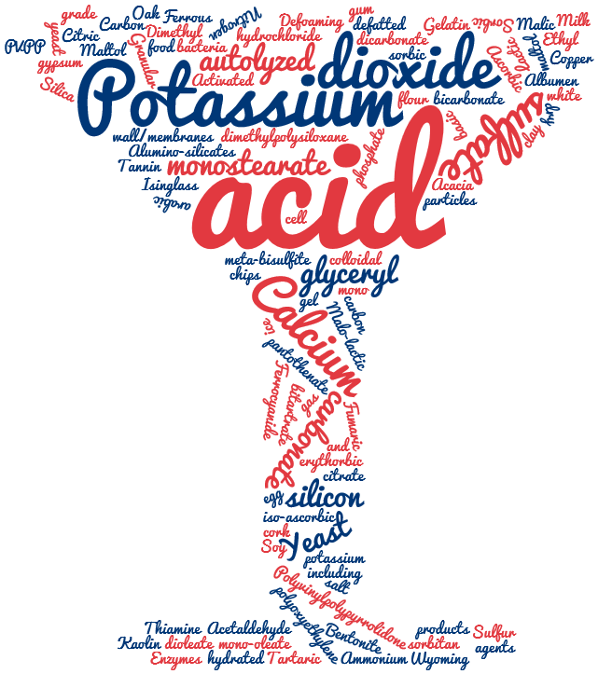
Additives and Processing Aids
To distinguish between these two can be difficult
Does it remain?
Is it removed, or is it intended that most of it is removed?
Citric Acid?
Activated Carbon?
Tartaric Acid?
Diammonium Phosphate?

Slide 9
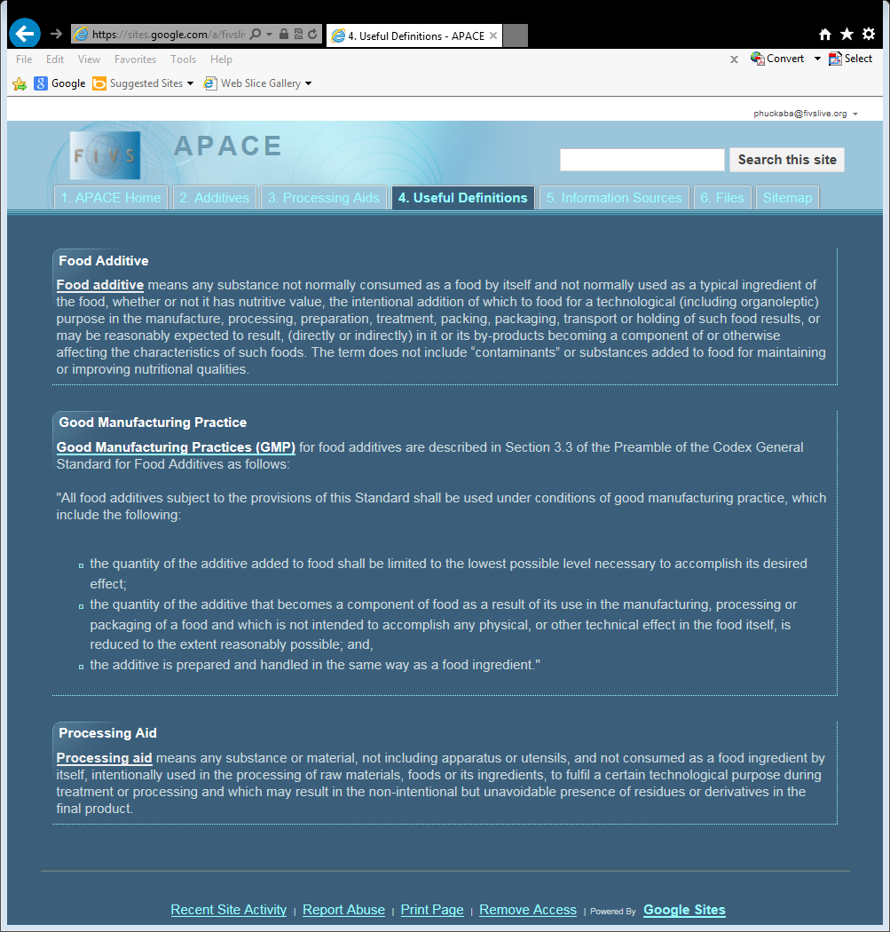
Additives and Processing Aids
A helpful resource:
FIVS – APACE
Additives and
Processing
Aids
Codex for
Enology

Slide 10
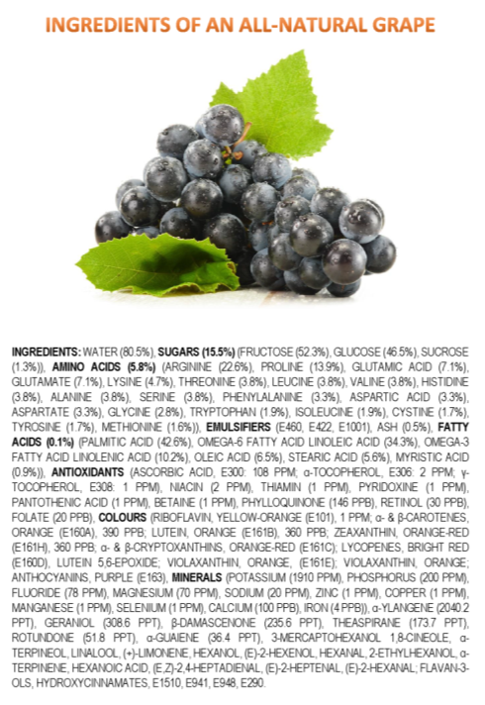
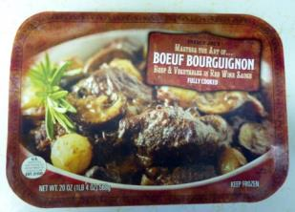
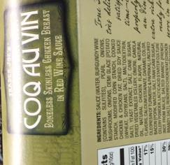
Wine is a single ingredient food
It is a historical beverage
The customer understands what it is
There is precedent
European Community (2009) AGRICULTURAL PRODUCT QUALITY POLICY: IMPACT ASSESSMENT
“…single-ingredient processed product (wine, olive oil, etc.)…”
“-Single-ingredient pressed or processed products (wine, dairy products including cheese, olive oil, coffee, tea, fats and oils, sugar, tobacco)”
http://ec.europa.eu/agriculture/quality/policy/com2009_234/ia_annex_a1_en.pdf
(https://jameskennedymonash.wordpress.com/)

Slide 11
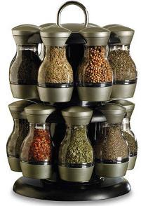
Wine is not a recipe product
Not all the substances are used for every wine
Grape Color / Grape Variety
Winemaking Style
Grape Region / Vineyard / Part of each vineyard
Winemakers don’t use everything on the list
Quality considerations
Cost considerations
I don’t even use the same things each year, or each time I bottle.
Vintage | 2013 | 2013 | 2014 | 2014 | 2015 | 2015
Blend Month | March | June | August | January | August | September
Total Acidity | 6.16 g/L | 5.28 g/L | 4.85 g/L | 4.77 g/L | 5.91 g/L | ?
Add Citric? | No | 5 units | 8 units | 7 units | No | ?

Slide 12
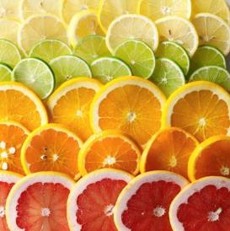
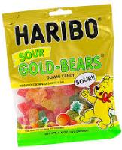
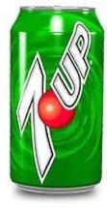
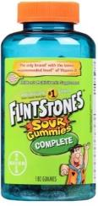
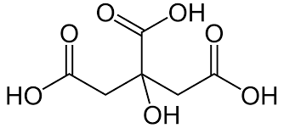
Winemaking substances are safe
The substances permitted in wine are safe to the consumer. The vast majority are either foodstuffs themselves, occur naturally in grapes / wine, or else have been evaluated by JECFA and given an “ADI not specified” designation.
JECFA – Codex Alimentarius Joint Expert Committee on Food Additives
ADI – Acceptable Daily Intake – “the amount of the additive, expressed on a body weight basis, that can be ingested daily over a lifetime without appreciable health risk (notionally ‘zero’ risk).”
ADI not specified – “the total daily intake of the substance…does not …represent a hazard to health” (http://www.fao.org/docrep/008/ae922e/ae922e05.htm)
Citric Acid

Slide 13
Numerical Limits vs. GMP
What does GMP mean?
The Codex Alimentarius General Standard for Food Additives (GFSA) states:
"All food additives subject to the provisions of this Standard shall be used under conditions of good manufacturing practice, which include the following:
the quantity of the additive added to food shall be limited to the lowest possible level necessary to accomplish its desired effect;
the quantity of the additive that becomes a component of food as a result of its use in the manufacturing, processing or packaging of a food and which is not intended to accomplish any physical, or other technical effect in the food itself, is reduced to the extent reasonably possible; and,
the additive is prepared and handled in the same way as a food ingredient."
http://www.fao.org/gsfaonline/reference/glossary.html

Slide 14
Numerical Limits vs. GMP
Numerical Limits can cause trade issues due to
Differences in markets
Confusion due to different scientific units used to express those limits
examples: g/L, mg/L, mg/dm³, mg/mL, mg/cm³, meq/L, g/kg, mg/kg, ppm
How would this affect Citric Acid use in the blend I’m making?
What if I wanted to export this to another country?
What if they had a numerical limit, especially if it wasn’t based on health concerns?
What if they had GMP as a usage guide?
Numerical Limits – sometimes based on usage?
Citric Acid – a Sequestrant? an Acidifier? a Stabilizer?

Slide 15
What about Codex Alimentarius Substances?
Codex allows only the following five compounds for grape wines (14.2.3):
Dimethyl Dicarbonate (DMDC)
Sulfites
Carbon Dioxide (CO₂)
Sorbates/Sorbic Acid
Lysozyme
(http://www.fao.org/gsfaonline/docs/CXS_192e.pdf)
What happens when an economy just allows these five?
What is missing from this list that a winemaker might want to use?
Acidifying agents, Fining agents, Yeast Nutrients, other?

Slide 16
Trade Issues…
There is potential for complications arising from the use of synonyms to describe the substances permitted for use in winemaking
Synonyms Confusion
Tartaric Acid CAS #526-83-0
(D,L)-Tartaric Acid
2,3-Dihydroxysuccinic Acid
Threaric Acid
Racemic Acid
Uvic Acid
Paratartaric Acid
L(+) Tartaric Acid CAS #87-69-4
Synthetic L(+) Tartaric Acid
Confusing names
DAP - Diammonium Phosphate, CAS #7783-28-0
DAP is also known as Diammonium hydrogen phosphate, Ammonium monohydrogen phosphate, and Ammonium phosphate, dibasic. DAP is a fermentation promoter, serving as a source of nutrition for yeast.
Molecular formula = (NH₄)₂ HPO₄
Ammonium Phosphate, CAS #10361-65-6
Ammonium phosphate is also known as Triammonium phosphate. Ammonium phosphate is a highly unstable compound and not used in winemaking.
Molecular formula = (NH₄)₃ PO₄
Ammonium Dihydrogen Phosphate, CAS #7722-76-1
Ammonium dihydrogen phosphate (ADP) is also known as Monoammonium phosphate. Ammonium dihydrogen phosphate forms large crystals and widely used in the field of optics. It is also used in some fire extinguishers.
Molecular formula = NH₄ H₂PO₄

Slide 17
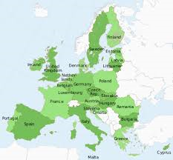
More Trade Issues
Trade issues can occur where different (but safe) winemaking practices are permitted in different markets.
Approaches to resolve these trade issues:
Harmonization – This is potentially difficult in scenarios where there is no existing movement to create a single market. An example that does work is in the European Union where there is a , harmonized set of regulations for the 28 member states. (Commission Regulation EC 606/2009)
Mutual Acceptance approach – The World Wine Trade Group (WWTG) uses this approach. Simply put, if the substance is safe, an importing economy will accept wines made with the substance, even if it is not allowed in their economy.

Slide 18
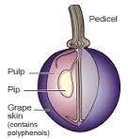
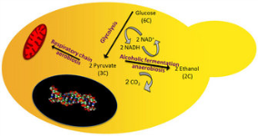
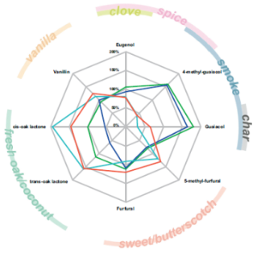
More Trade Issues
Trade issues can develop around “adventitious substances” in wine
Sources can include:
Grapes
Yeast or Bacteria Fermentation products
Oak-related compounds
Eugenol
Isoeugenol
Furfural
5-Methylfurfural
Guaiacol
4-Methylguaiacol
Oak Lactones (cis- and trans-)
(http://winefolly.com/review/oaking-wine)
Just because a compound is present in wine, that isn’t a guarantee that it was directly added.
(www.bouchardcooperages.com)

Slide 19
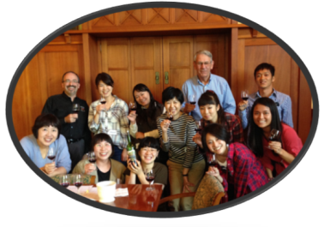
Conclusions
Winemaking Substances are safe.
Most are naturally occurring.
Most supplement what is already present.
Because grapes vary, the substances (and amounts) used will vary.
A GMP approach, particularly when the ADI is “not specified”, can remove many barriers to trade.
Using the 5 Winemaking Substances in Codex is not enough.
Where possible, can we identify unnecessary barriers to trade and…
Eliminate sources of confusion?
Promote an understanding of the compounds found in wine?
Remove these barriers?

Slide 20
Substances Permitted for use in Winemaking —A Winemaker’s Story
Questions?
Thank you.

