Slide 1
ECONOMIC SUSTAINABILITY Breaking Down Trade Barriers
Rachel Triggs
General Counsel
Wine Australia
FIVS, Hawaii, October 2018

Slide 2
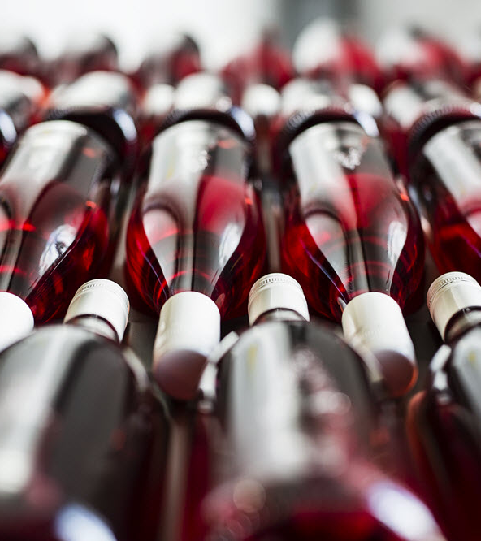
Overview
What are the current and the emerging non-tariff impediments to international trade in wine?
How are key international organisations and industry bodies engaging?
What are the future areas for work?

Slide 3
Non-tariff Trade Barriers for wine (just a few)
Permitted additives and processing aids
Use of mannoproteins and pectins in China
Copper sulphate in Japan
China – new limit for Ochratoxin A (2ppb) (follows limits being imposed for manganese)
Ascorbic acid in Korea (and China)
Grape skin extract (various)
Differing MRLs
Differing rules on standard drinks labelling
Differing rules on ingredient listing and nutrition/calorie labelling
Differing rules relating to the use of multiple GIs
Differing rules relating to sustainability, organics and biodynamic
Mandatory health warnings
Sulphur dioxide limits
Alcohol tolerance differences
Sweetness indications
Differing MRLs
Archaic compositional requirements (e.g. sugar free extract)
Differing certification requirements
Use of protected terms that are also grape varietal names (Prosecco, Avola and Montepulciano)
Product ‘type’ designation - becoming more of an issue as a result of the recent proliferation of wine products, wine based beverages, fruit wine.

Slide 4
https://www.wineaustralia.com/news/articles/know-your-sulphite-limits
https://www.wineaustralia.com/news/articles/label-alcohol-tolerance-by-market

Slide 5
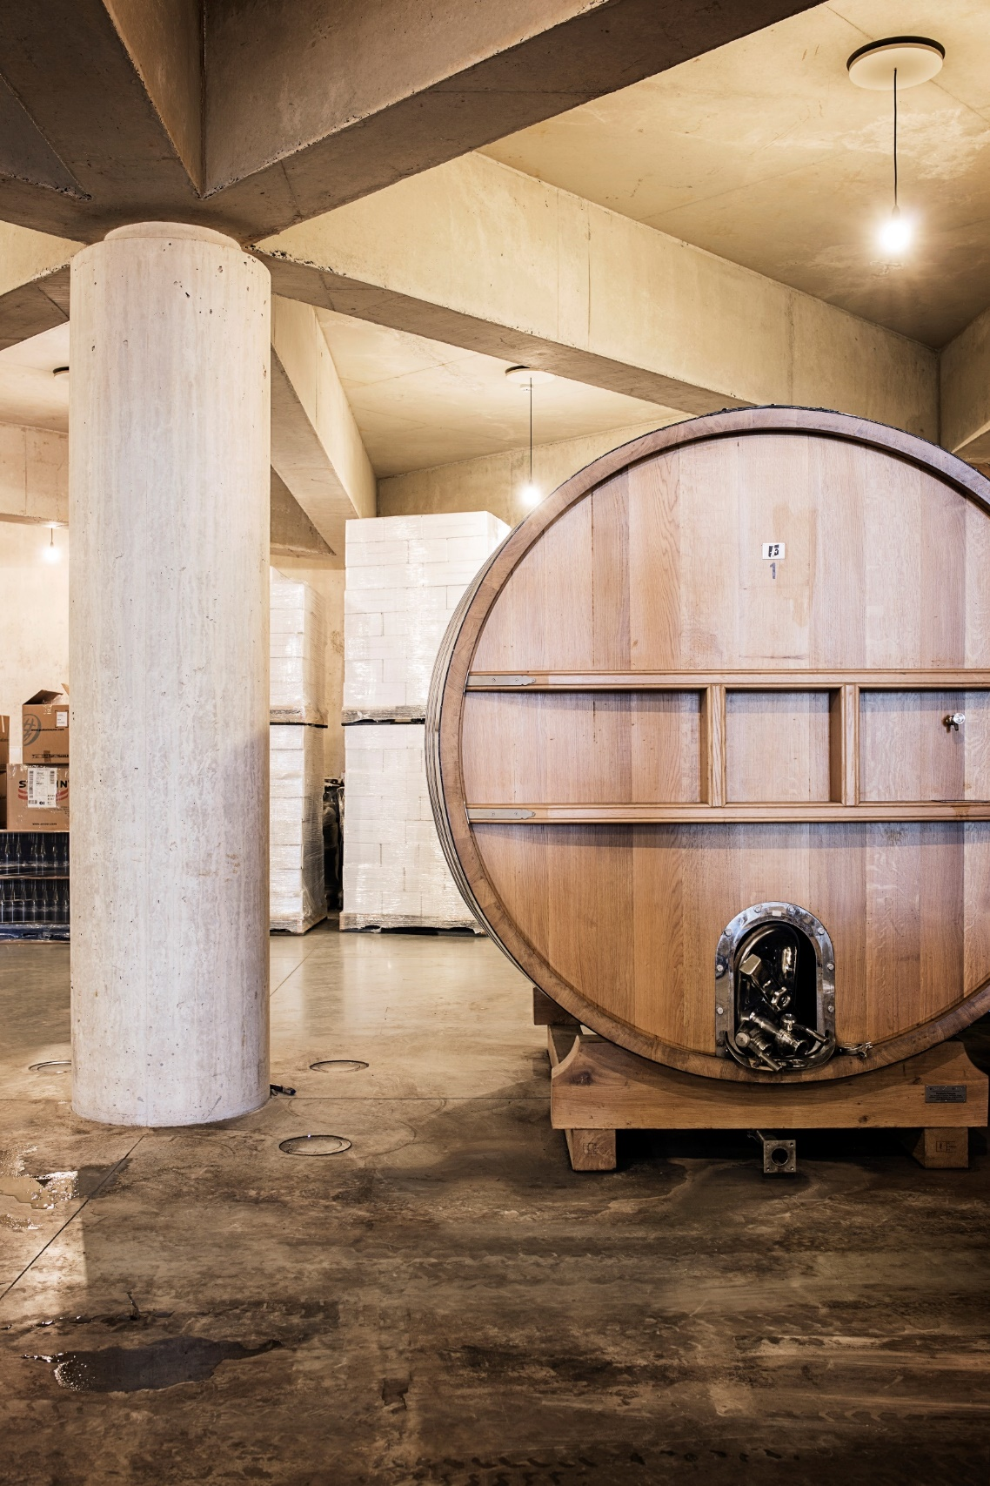
Group discussion
Should there be a template wine agreement and if so what form should it take?
Onerous certification and analysis requirements– how could and how should these be eliminated?
Codex Alimentarius – how are we doing and can we do a better job?
Copycat brands. What is being done and is there a role for FIVS?
Anti-counterfeiting – is there a role for FIVS?
Effect of Brexit, Chapter 22 and the classification of alcoholic beverages
IP and GI initiatives (including dealing with GIs that are also grape varietal names)
How do we go about eliminating or reducing trade barriers caused by restrictive additives and processing aids?

