Slide 1

Wine Trade in the APEC region
Peter Bailey – Wine Australia
APEC WRF November 2015 | Adelaide Australia
APEC Wine Regulatory Forum
Adelaide | Australia

Slide 2
Presentation Outline
Content
  APEC wine global context
  APEC wine imports
  APEC wine exports
  Wine trade within APEC

Slide 3
APEC wine global context
Category | Measure | APEC economies | World total | APEC share
Population | billion people | 2.8 | 7.2 | 39%
Wine consumption | billion litres | 8.0 | 24.5 | 32%
Per capita wine consumption | litres per capita | 2.8 | 3.4
Wine imports | billion litres | 3.5 | 11.0 | 31%
Wine exports | billion litres | 2.4 | 11.6 | 20%
Wine production | billion litres | 7.8 | 28.2 | 28%
Notes:
APEC accounts for 39% of the world’s population but 32% of the world’s wine consumption – this suggests there may be upside in wine consumption in the APEC region. If APEC held a 39% share of wine consumption, that would equate to an additional 1.6 billion litres of wine sales.
APEC per capita consumption is at 2.8 litres per head trails the world average of 3.4 litres per head.
APEC economies import more wine than they export – 3.5 million litres v 2.4 million litres.
Exports account for 31% of the wine produced by APEC – this is lower than the export share of world wine production of 41%.

Slide 4
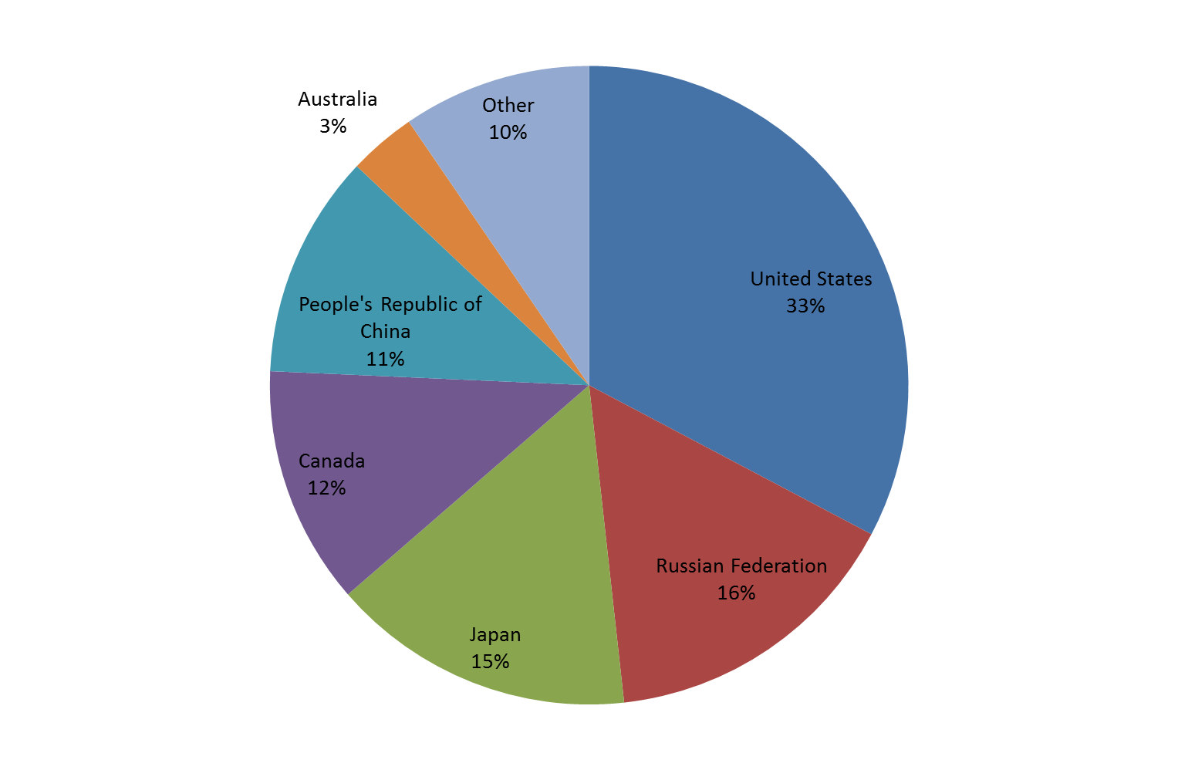
APEC wine imports – 90% to 6 economies
Notes:
Wine imported by APEC economies totalled 3.5 billion litres in 2014. The APEC share of world imports has grown from 29% in 2011 to 31% in 2014.
90% of this volume in 2014 went to 6 economies:
The US with 33%
Russian Federation at 16%
Japan at 15%
Canada at 12%
People’s Republic of China at 11%
Australia with 3%.
The rest of the APEC economies account for 10%.
While total world wine imports grew 0.4% between 2011 and 2014, wine imported by APEC economies grew by 8% and the rest of the world declined by 3%. Of the 21 APEC economies, 18 recorded growth in wine imports. Of the 6 major wine importing economies in APEC, the strongest growth in imports over the period was to Japan (up 16%), Australia (up 15%) and Canada (up 11%).

Slide 5
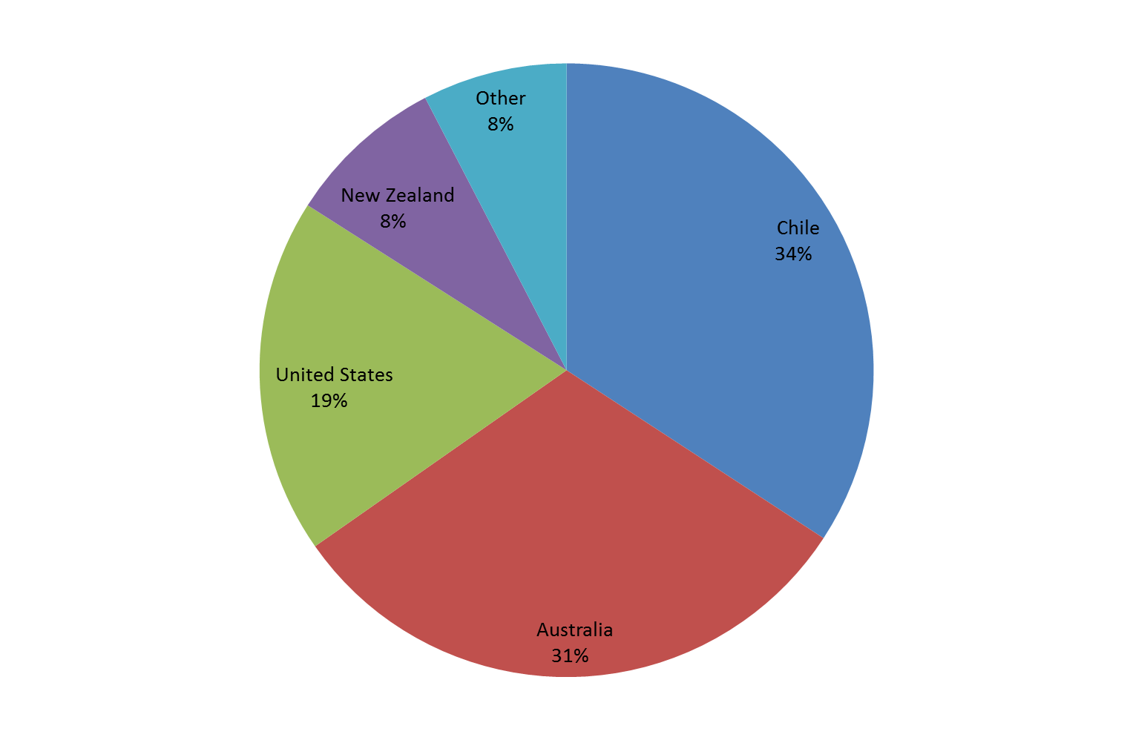
APEC wine exports – 92% from 4 economies
Notes:
APEC economies exported 2.4 billion litres of wine in 2014. This APEC share of world wine exports has grown from 18% in 2011 to 20% in 2014.
92% of the wine exported from APEC came from 4 economies:
Chile (34%)
Australia (31%)
The United States (19%)
New Zealand (8%)
Wine production in each of the four major exporters increased during the period, showing each economy had more wine available to export.
APEC economies are driving growth in world wine exports. Exports from APEC economies grew by 12% between 2011 and 2014 to reach 2.4 billion litres. In comparison, wine exports from the rest of the world over the same period declined by 0.5%. Wine exports grew from 14 of the 21 APEC economies.
Exports from each of the 4 big APEC wine exporters grew over the period:
Chile up 21%
Australia up 2%
USA up 5%
NZ up 12%

Slide 6
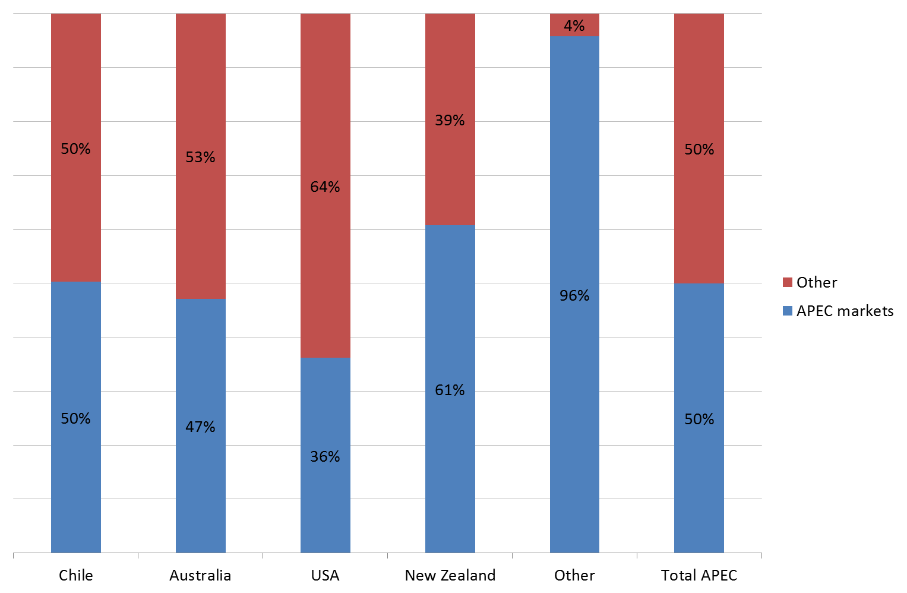
Wine trade within APEC
Notes:
Half the wine exported from APEC economies was destined for other APEC economies in 2014. There are mixed results for the major four exporters:
New Zealand has the biggest exposure to APEC economies, with 61% of its exports destined for APEC markets
The US has the lowest exposure, with 36% shipped to APEC markets
Chile and Australia each ship around half its wine exports to APEC markets.
The smaller exporters almost exclusively ship to APEC economies.
In conclusion, APEC economies have been increasing their share of wine trade around the world, taking share from other producers, particularly in Europe.

